Slide 2
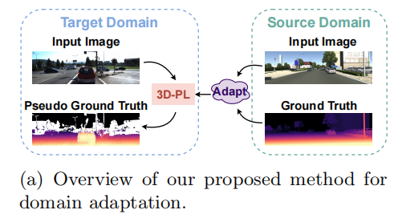
motivation / contribution
-有监督的depth estimation方法需要大量的真实数据
-无监督的方法在有遮挡或模糊时效果不好
-最近使用的合成数据集方法domain adaptation表现不好
-depth estimation是一个regression任务，需要特定的设计来进行pseudo-labels生成。本文提出了一种新的pseudo-labeling方法来进行domain adaptation的depth estimation

Slide 3
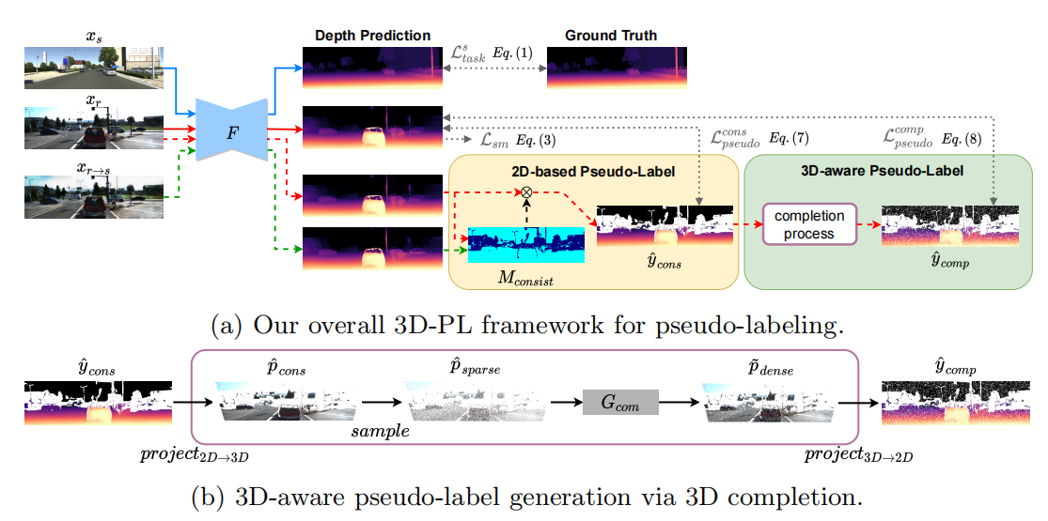

Slide 4
Preliminary Model Objectives
首先用合成数据训练一个初步的深度估计模型F，然后用F来推断真实数据的伪标签进行自我训练：
用synthetic image-depth pairs (x_{s}, y_{s})和真实的图像x_{r}来描述Preliminary Model Objectives，包括Depth Estimation Loss和Smoothness Loss

Slide 5
Pseudo-Label Generation —— 2D-based Consistency Label
向模型提供两个具有相同contents但不同style的target images，更confident的像素应该在两个预测中具有更一致的深度值:
首先用AdaIN获得了synthetic-stylized image x_{r→s}，它结合了真实图像x_{r}的内容和合成图像x_{s}的风格
得到两幅图像的深度预测：${\tilde{y}}_{r}=F(x_{r}),$ ${\tilde{y}}_{r→s}=F(x_{r→s})$
并计算他们地差值，如果这个差值小于阈值，则认为这个像素high-confident，并以此形成Pseudo-Label ${\hat{y}}_{cons}$

Slide 6
Pseudo-Label Generation —— 3D-aware Completion Label
Project the 2D-based pseudo-label ${\hat{y}}_{cons}$ to point clouds ${\hat{p}}_{cons}={project}_{2D→3D}{(\hat{y}}_{cons})$ in the 3D space
Reconstruct each point (x_{i},y_{i},z_{i}) from the image pixel (u_{i},v_{i}) with its depth value d_{i} based on the standard pinhole camera model
均匀采样得到稀疏点云
将稀疏点云作为 3D completion model G_{com}的input，合成缺失点
生成密集点云再映射回2D图像形成深度值d，标签 ${\hat{y}}_{comp}$

Slide 7
Pseudo-Label Generation —— 3D Completion Model
Pre-train the 3D completion model G_{com} using the synthetic ground truth depth y_{s} in advance and keep it fixed during completion process.

Slide 8
Overall Training Pipeline and Objectives
第一阶段是训练一个初步的深度模型F
第二阶段是通过这个初步模型应用pseudo-labeling techniques
Stereo Setting ：进一步将[56]中的 geometry consistency loss L_{tgc}纳入到所提出的方法中：
56. Zhao, S., Fu, H., Gong, M., Tao, D.: Geometry-aware symmetric domain adaptation for monocular depth estimation. In: IEEE Conference on Computer Vision and Pattern Recognition (CVPR) (2019)

Slide 9
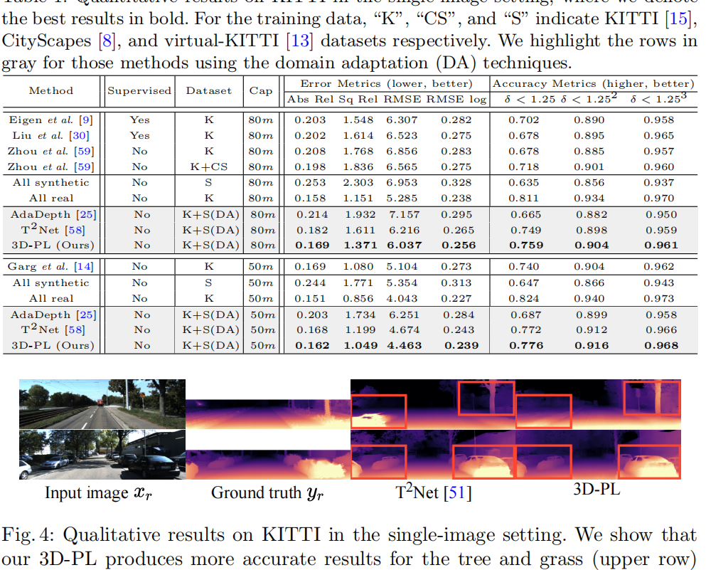
Experimental Results
adopt Virtual KITTI (vKITTI) and real KITTI as source and target datasets respectively

Slide 10
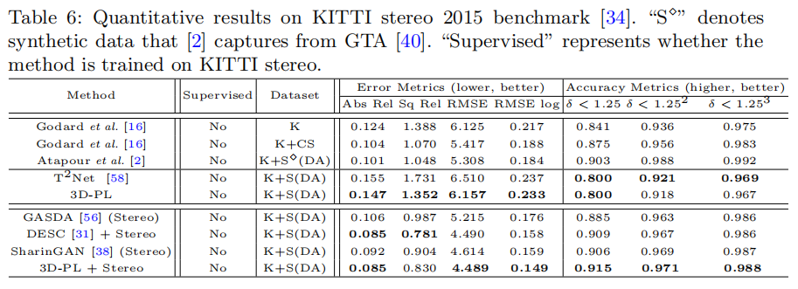
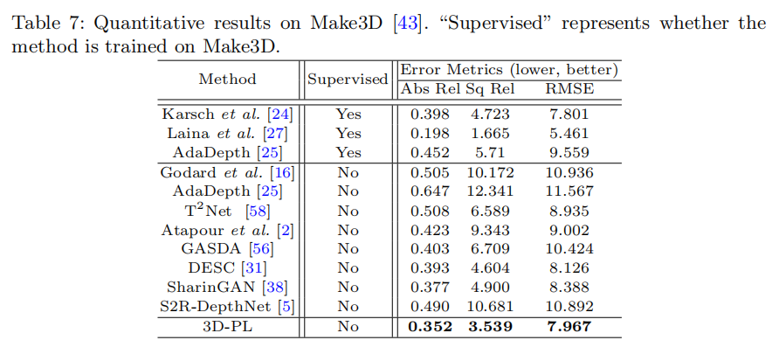
Experimental Results

