Slide 1
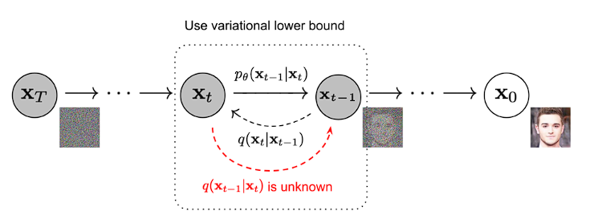

Slide 2
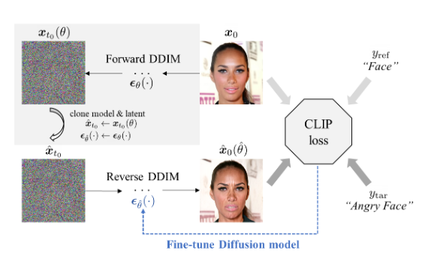
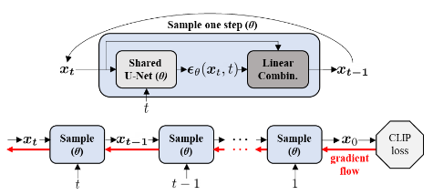

Slide 3
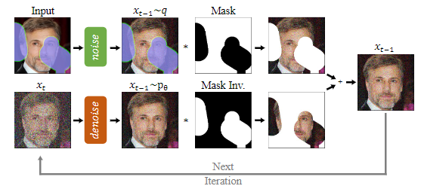
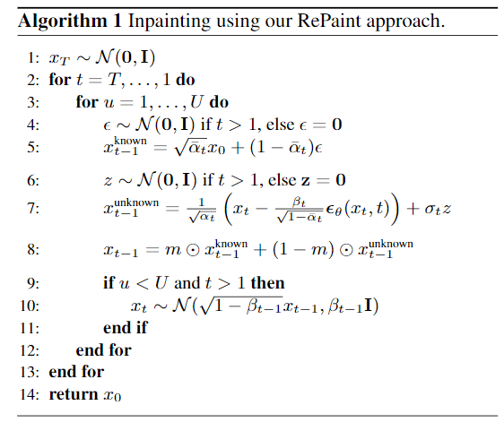

Slide 4
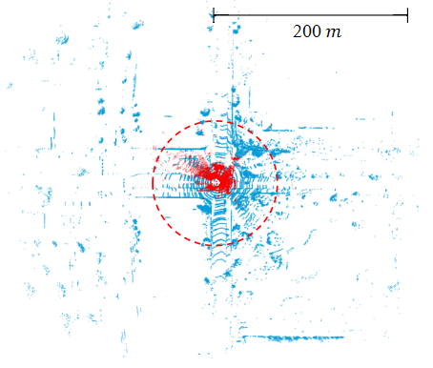
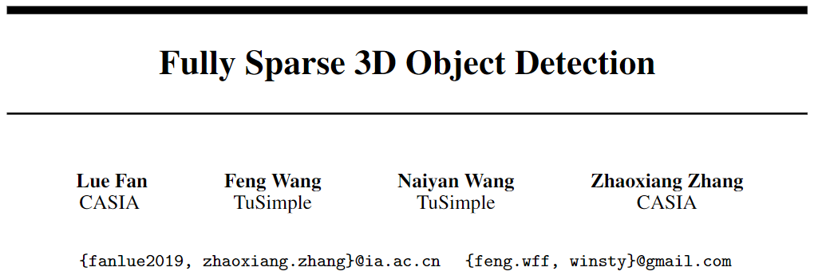
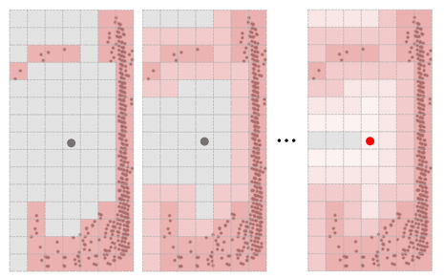
Motivation:
Dense detector: $Points \underset{→}{voxelize}Voxels\underset{→}{3D sparse conv}3D sparse map\underset{→}{flatten+2D conv}BEV dense maps\underset{→}{reg heads}Output$
Problems:
computational and spatial complexity on dense feature maps is quadratic to the perception range
label assignment in dense prediction when the center feature is missing
Revisit point-based method：Inefficiency of ball query & Coarse representation by point sample
Fully Sparse Detector(FSD) which takes the advantages of
both sparse voxel encoder and point-based instance predictor
group-based object predict without label assign and ball query

Slide 5
Instance Point Group:
Classification and Voting: vote the corresponding object center from foreground points
Connected Components Labeling: Two vertices are connected if their distance is smaller than a certain threshold, connected component in this graph can be viewed as an instance with same ID
Sparse Instance Recognition: feature extraction based Dynamic Broadcast/Pooling
Group Correction: correct id based on proposals

Slide 6
