Slide 1
CVPR ‘22

Slide 2
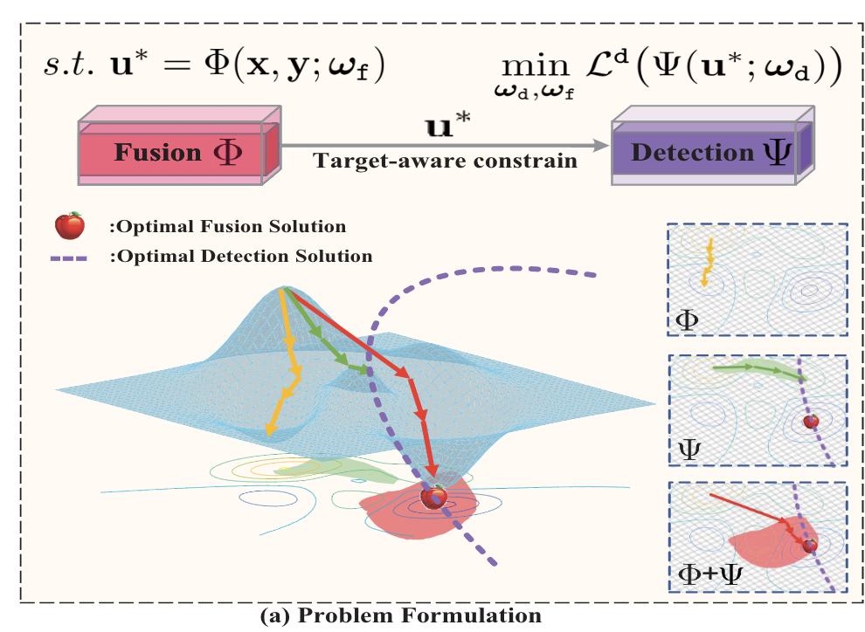
Method
Motivation:Previous approaches discover commons underlying the two modalities and fuse upon the common space either by iterative optimization or deep networks.
Problem formulation ： IVIF has to generate an image that benefits both visual inspection and computer perception

Slide 3
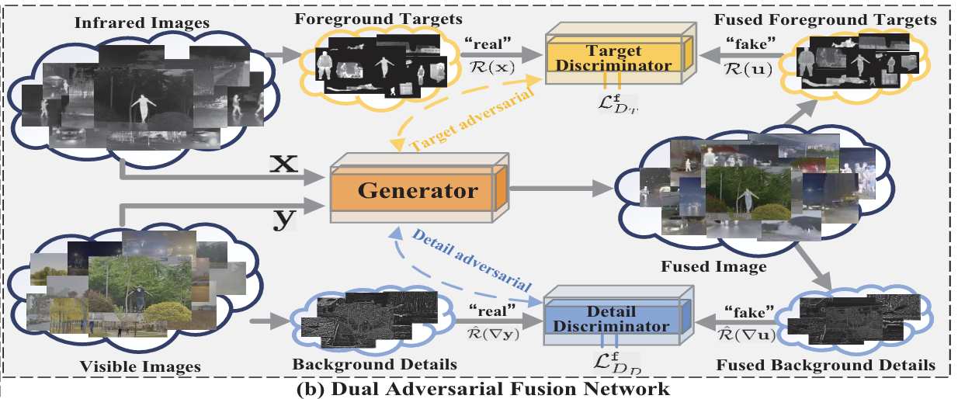
Method
Target-aware dual adversarial network:
Typically, the infrared highlights distinct structures of targets while the visible provides textural details of background.

Slide 4
Method
Generator:
Target and detail discriminators:

Slide 5
Method

Slide 6
Experiment

Slide 7
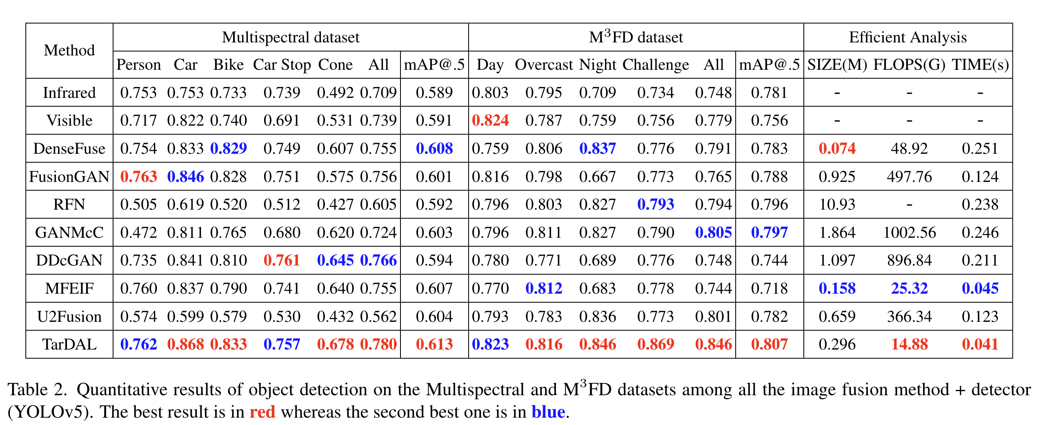
Experiment

Slide 8
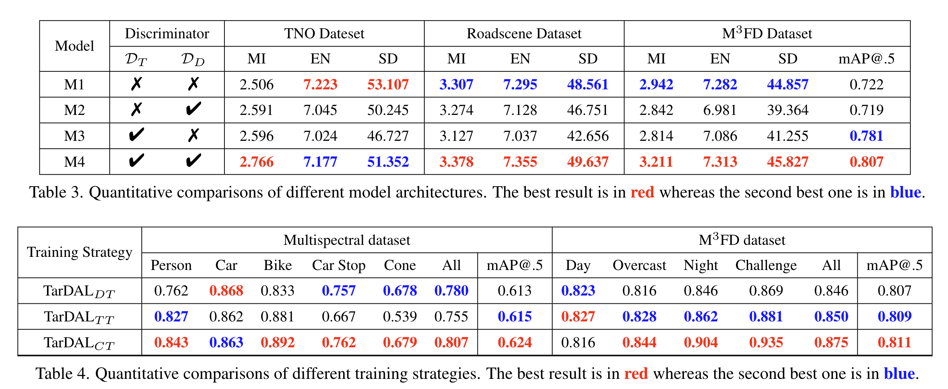
Experiment
Ablation Study：

Slide 9
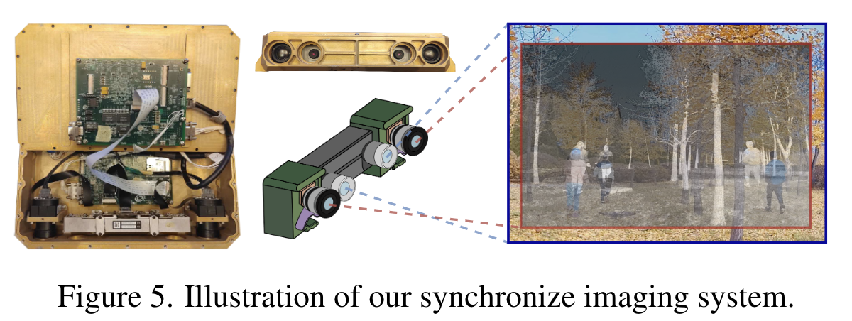
Benchmark

