Slide 1
CVPR2022

Slide 2
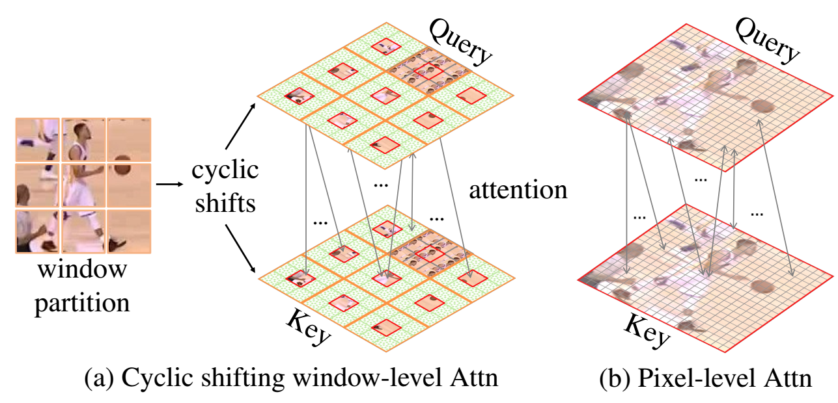
Motivation：
1. Cross-correlation used in Siamese trackers is not effective to explore the semantic information.
2. Pixel-level attention ignore the integrity of object.
Method:
Use window-level Attention in matching step of Siamese tracker.

Slide 3
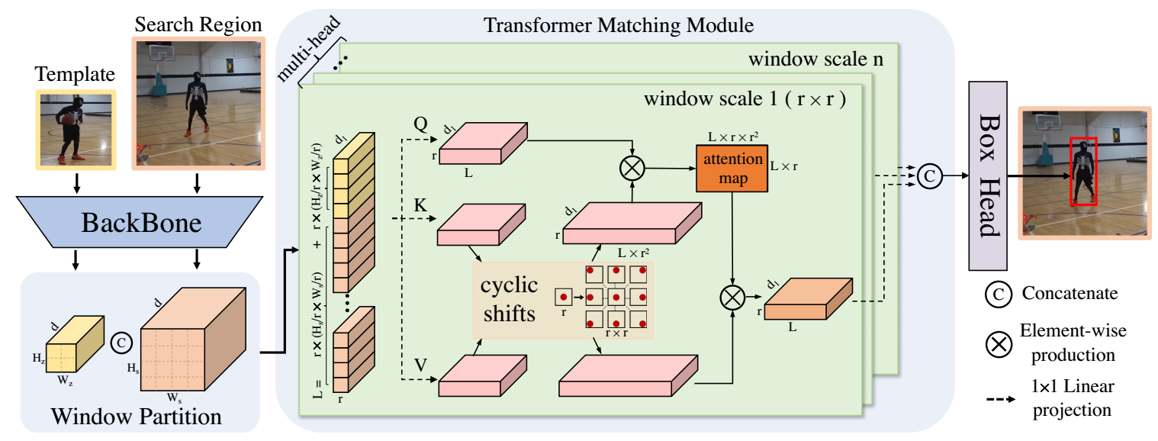
1. Multi-scale. A head corresponds a scale partition, (1, 2, 4, 8).
2. Cyclic shifts. To increase and unify the outputs of head, also can preserve positional info.
3. Spatially regularized attention mask. To penalty the large shifts.
4. Computation optimization.

Slide 4
1. Multi-scale. A head corresponds a scale partition, (1, 2, 4, 8, 1, 2, 4, 8).
The i-th head

Slide 5
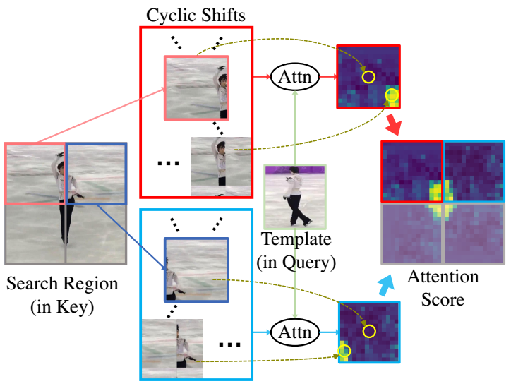
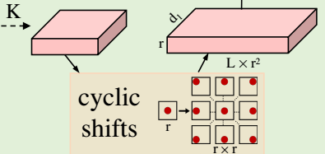
2. Cyclic shifts. To increase and unify the outputs of head, also can preserve positional info.

Slide 6
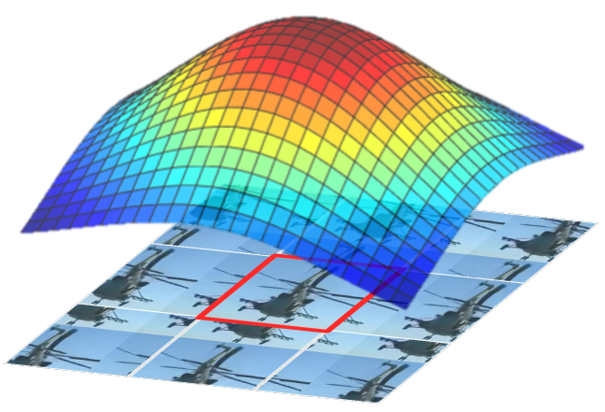
3. Spatially regularized attention mask. To penalty the large shifts.
add to
4. Computation optimization.
(i) eliminating the cyclic shifts of the Query
(ii) halving the duplicated shifting periods
(iii) adopting the programming optimization for matrix translation

Slide 7
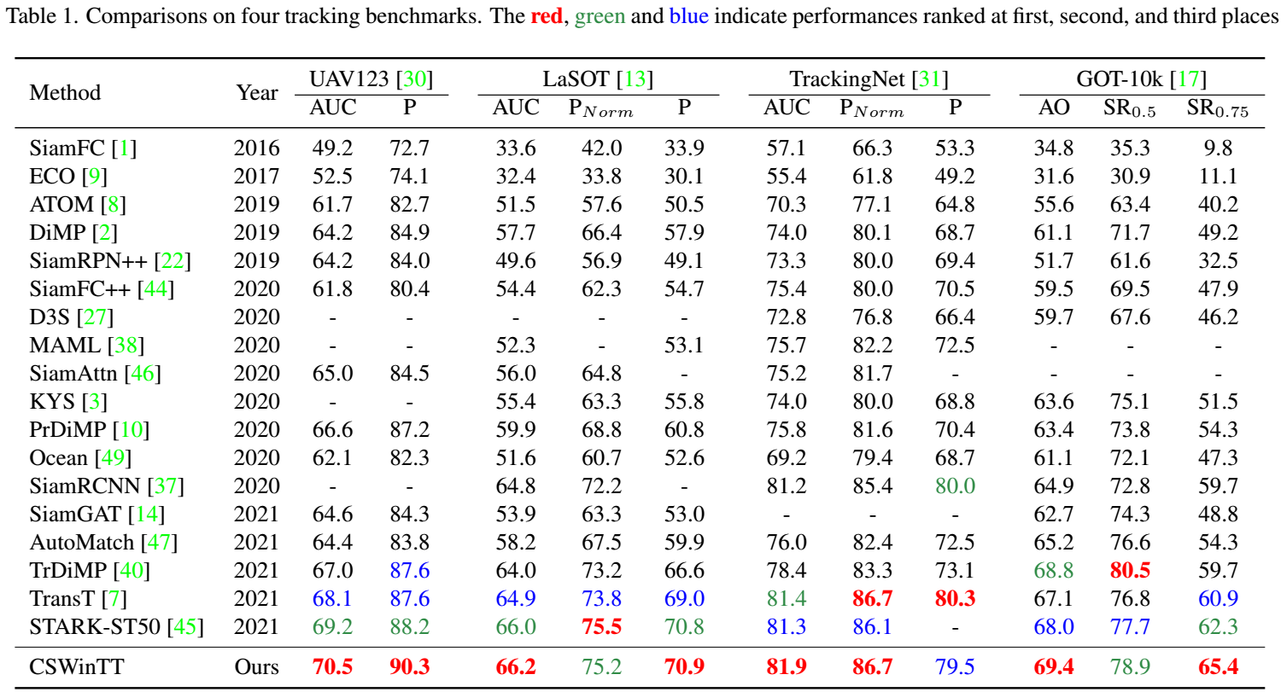
OSTrack-384 eccv22 70.7 71.1 83.9 73.7
OSTrack-256 --- 68.3 69.1 83.1 71.0

Slide 8
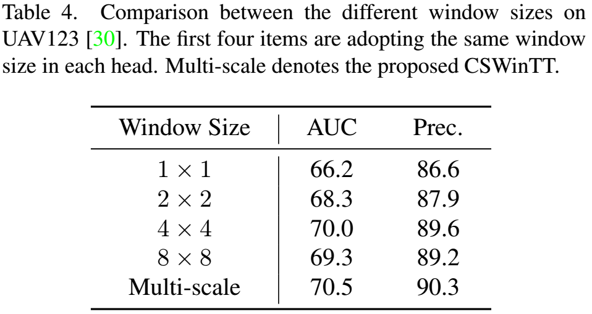
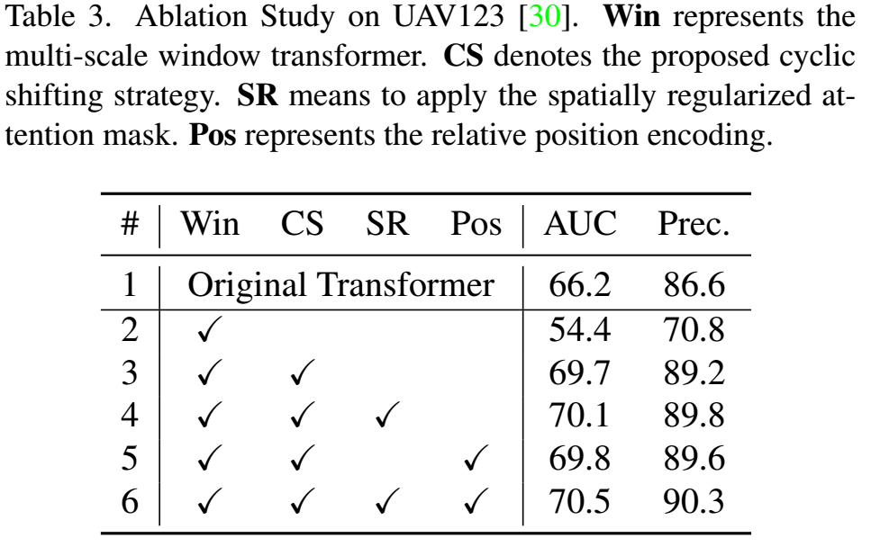
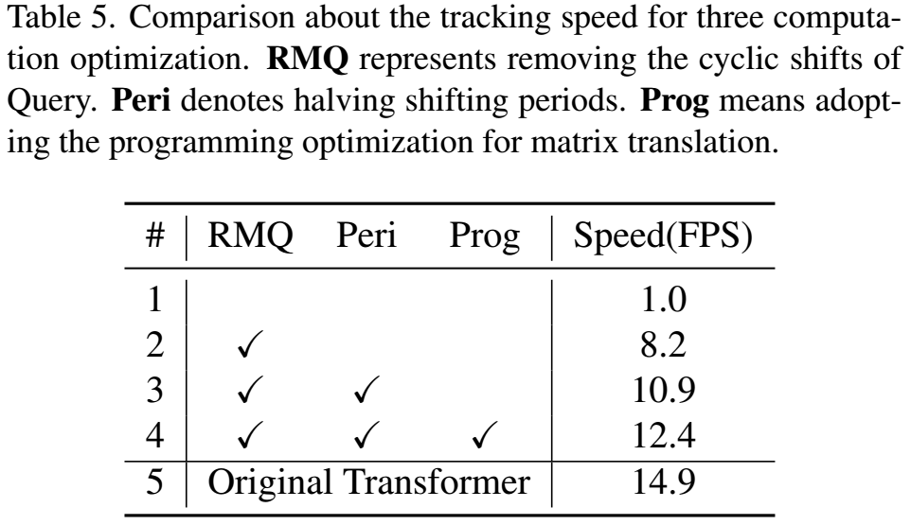
Ablation Study

Slide 9
