Slide 1
CVPR 2022 Final List

Slide 2
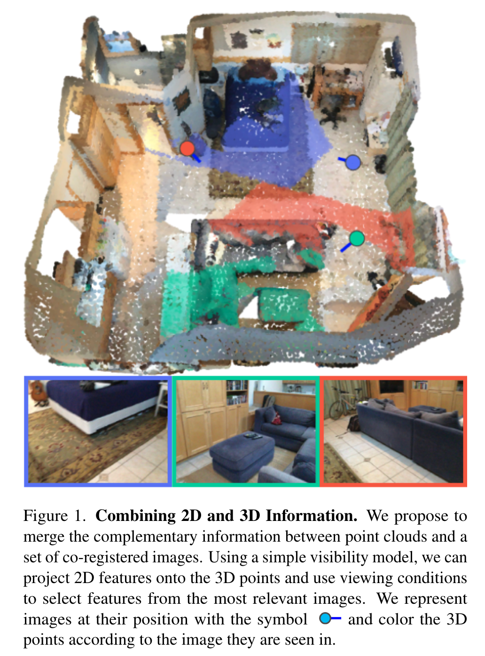
Motivation：
Merging large-scale point clouds and images raises several challenges：
constructing a mapping between points and pixels
aggregating features between multiple views
Current methods require
mesh reconstruction or depth sensors to recover occlusions for point-pixel mapping
use heuristics based on e,g. distance, viewing angle to select and aggregate available images
a end-to-end trainable multi-view aggregation model leveraging the viewing conditions of 3D points to merge features from images taken at arbitrary positions.

Slide 3
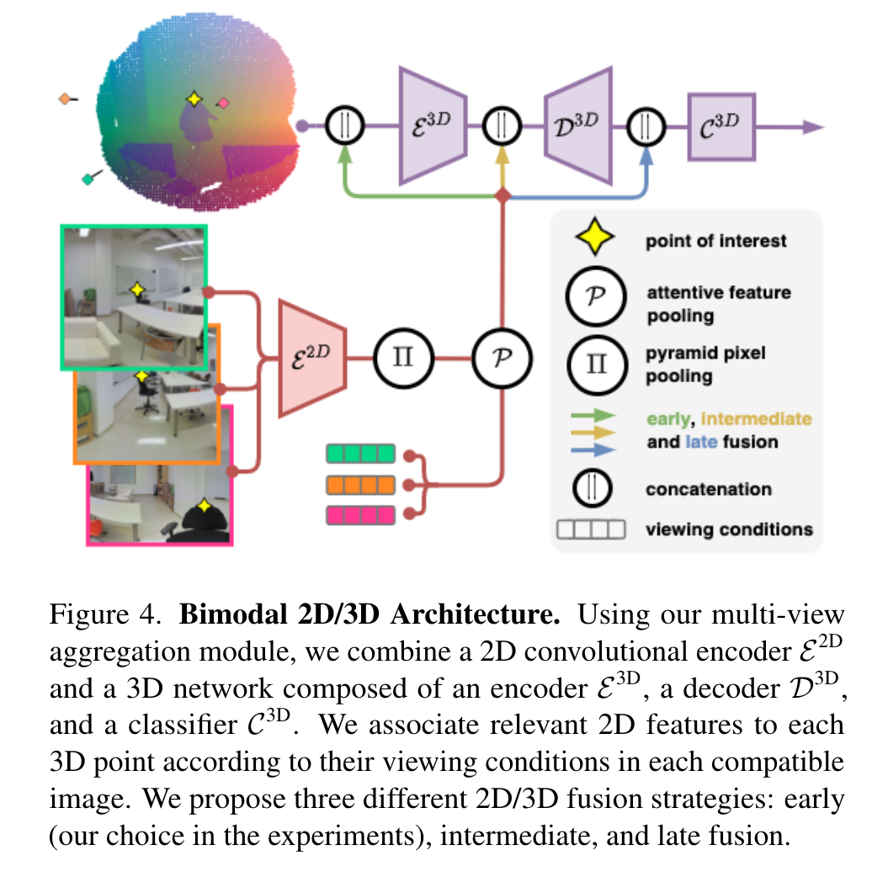
Method
离线建立Point-Image Mapping
在线通过2D/3D backbone分别提取
点云特征
该点visible的多个view图像的特征
基于图像的view conditions进行Attentive Feature Pooling得到global图像特征
将点云和global图像特征concat之后进行下游任务

Slide 4
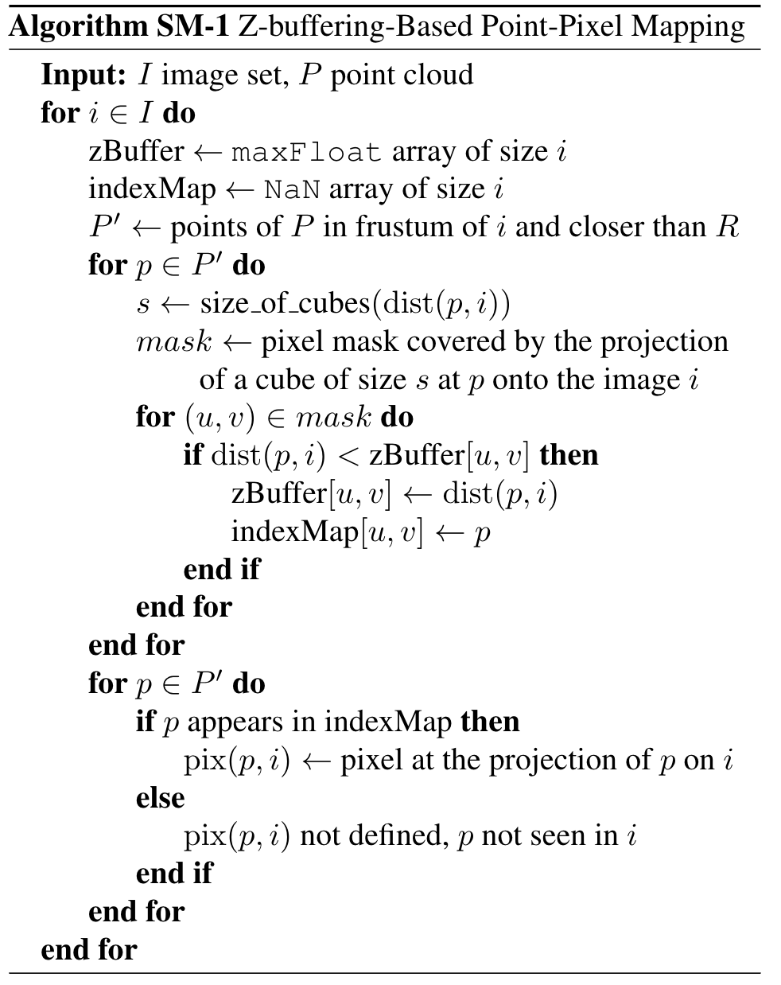
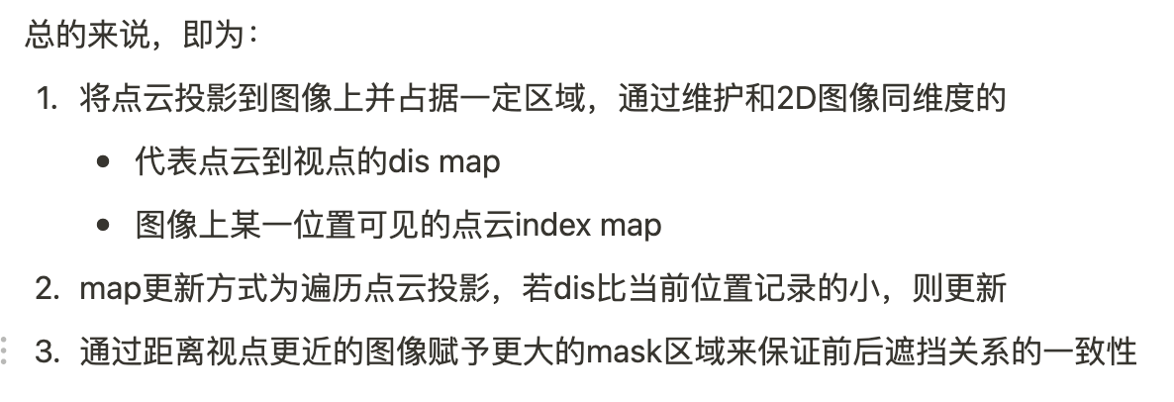
Point-Image Mapping

Slide 5
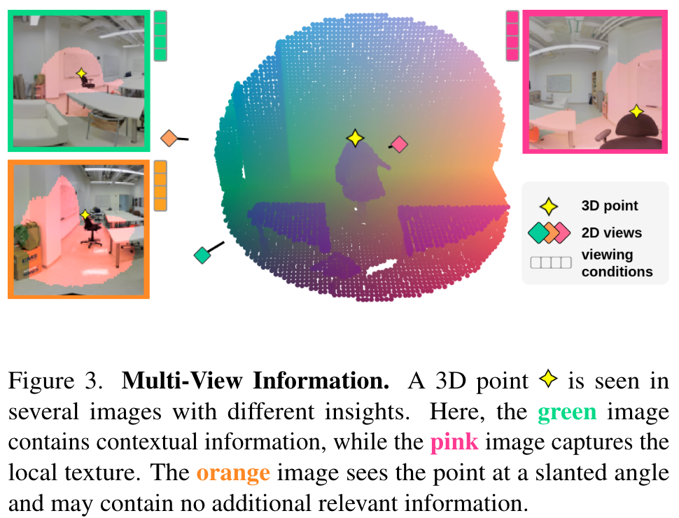
Attentive Feature Pooling
view condition
view feature
view quality
view score + gating
view fusion

Slide 6
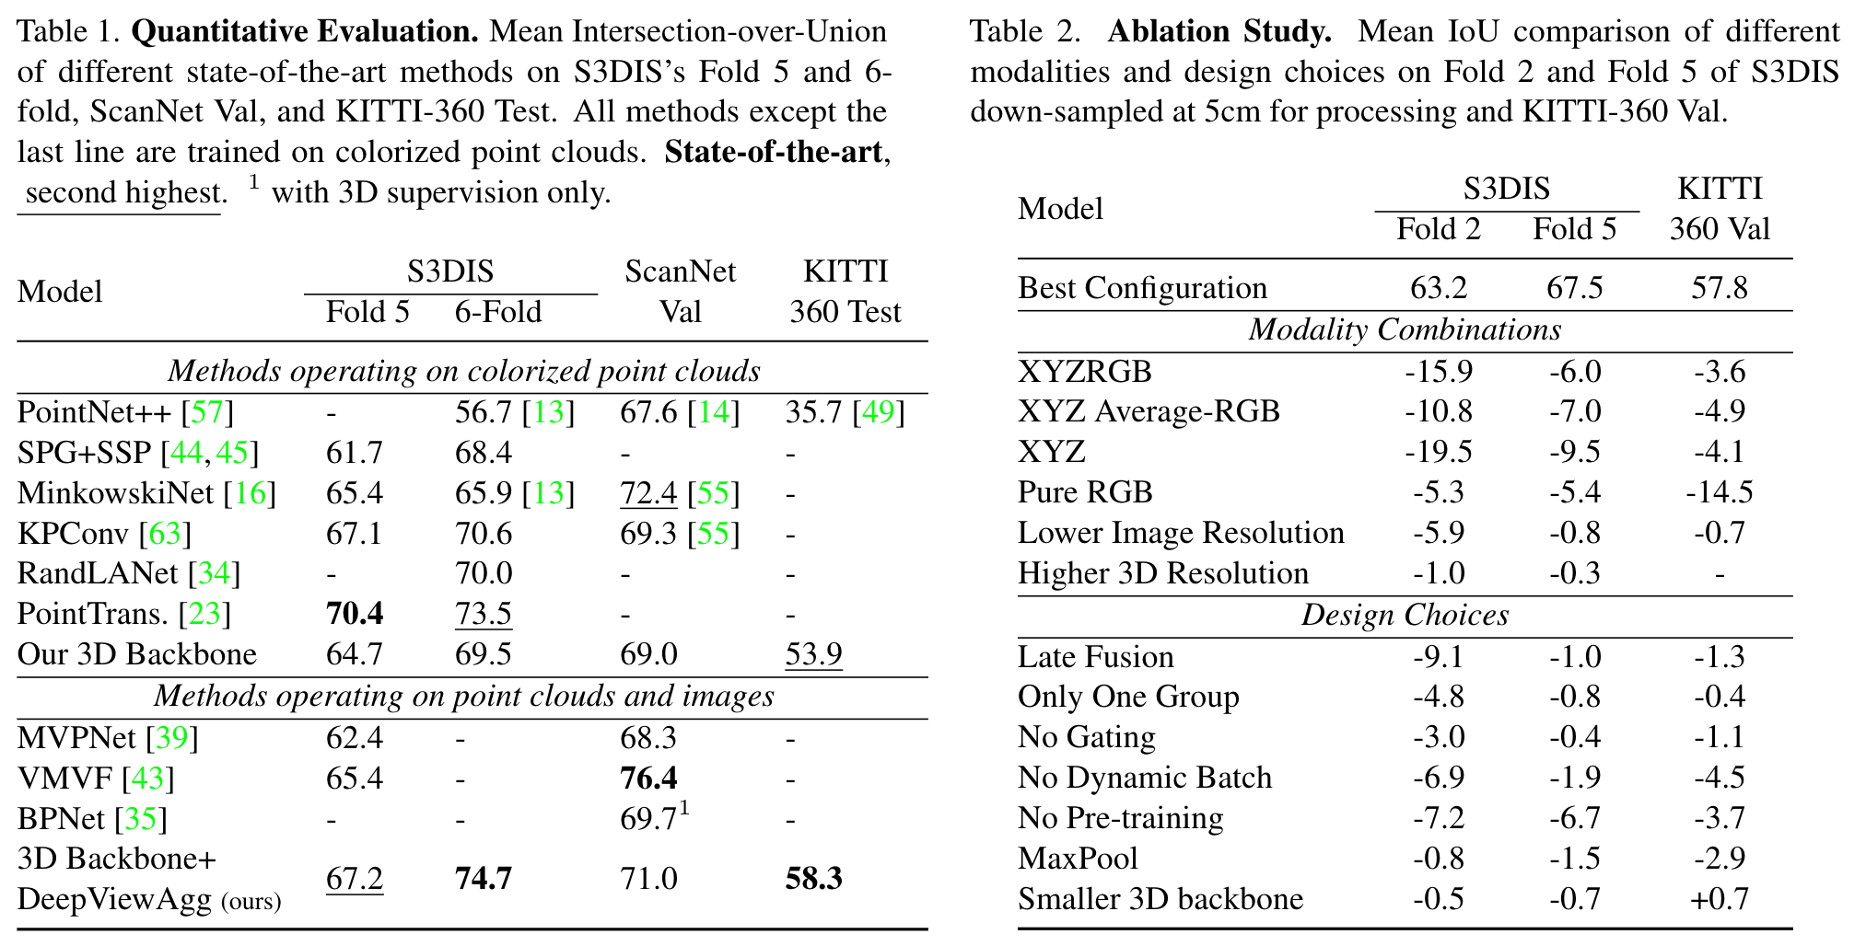
Experiment

