Slide 1
Compound Word Transformer: Learning to Compose Full-Song Music
over Dynamic Directed Hypergraphs
&
Structure-Enhanced Pop Music Generation via Harmony-Aware Learning
Aaron Huang
Hsiao W Y, Liu J Y, Yeh Y C, et al. Compound word transformer: Learning to compose full-song music over dynamic directed hypergraphs[C]//Proceedings of the AAAI Conference on Artificial Intelligence. 2021, 35(1): 178-186.
Zhang X, Zhang J, Qiu Y, et al. Structure-enhanced pop music generation via harmony-aware learning[J]. arXiv preprint arXiv:2109.06441, 2021.

Slide 2
CP(compound word representation)T(transformer)

Slide 3
Background-MIDI Tokenize + REMI
Music Sheet
MIDI-Like
Pop Music Transformer: Beat-based Modeling and Generation of Expressive Pop Piano Compositions
position-based
REMI

Slide 4
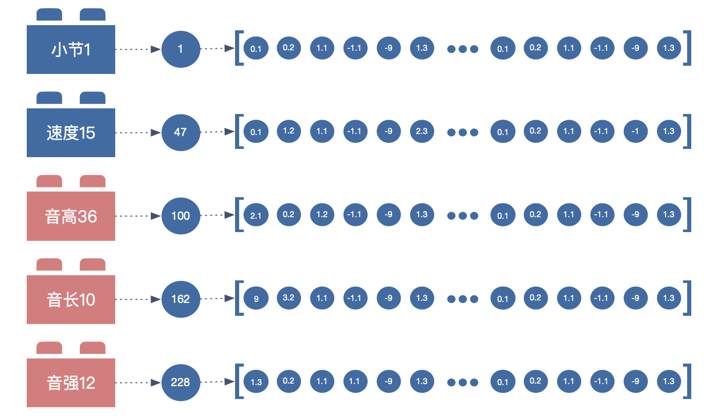
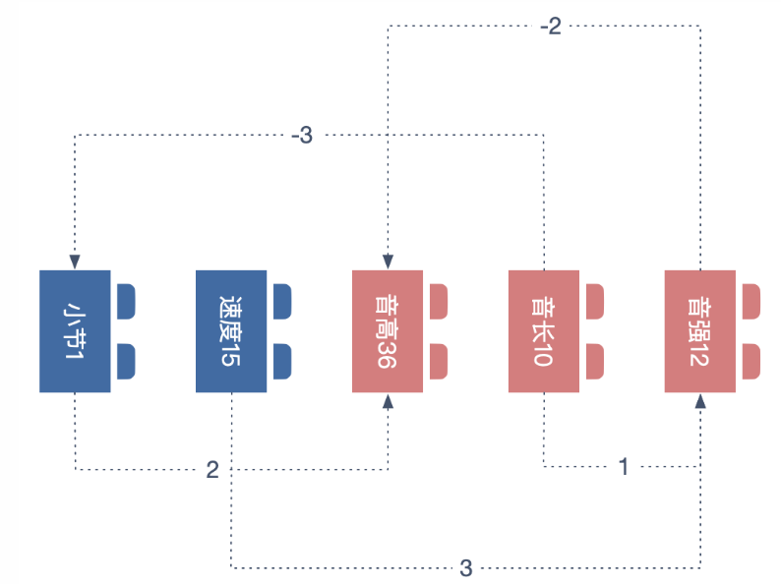
Attention + Relative Attention

Slide 5
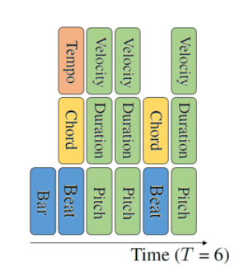
Compound Word
1. Neighboring tokens that define a musical event together are grouped into a super token

Slide 6
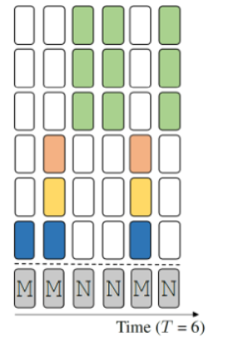
Compound Word
2. Fill the missing token types per time step with “[ignore]” tokens

Slide 7
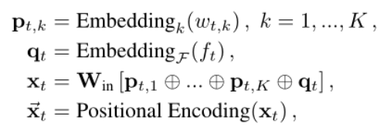
Embedding Process

Slide 8
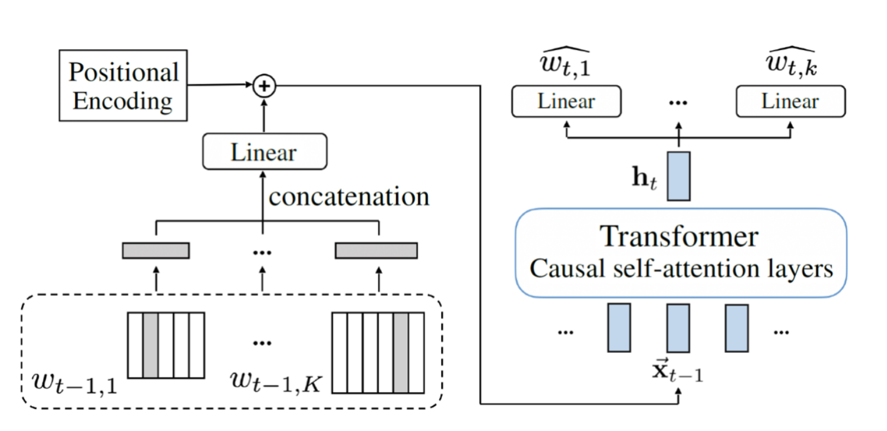
Compond Word Transformer-Two stage
easier for the model to predict [ignore]

Slide 9
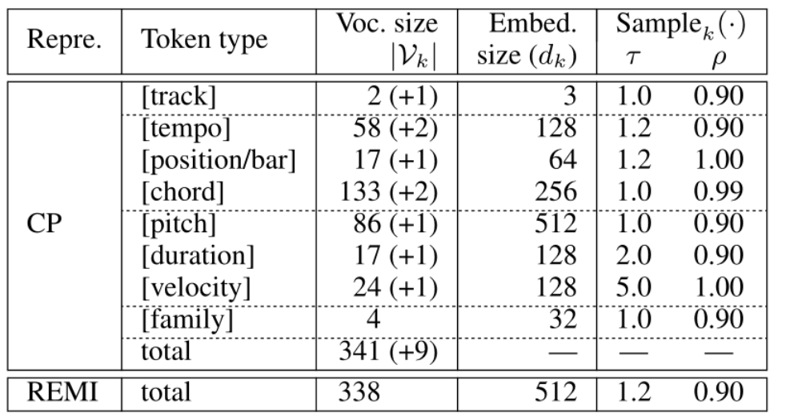
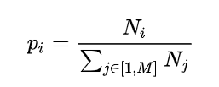
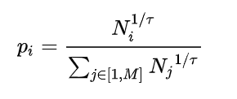
Sampling
stochastic temperature-controlled sampling
nucleus sampling

Slide 10
Implementation
Transformer XL/ linear:12 self-attention layers with 8 attention heads

Slide 11
HA(harmony-aware hierarchical )T(transformer)

Slide 12
Target
capture the highly mutual dependency be-tween form and texture
Metohd
leverage the evolution from chord to chord progression

Slide 13
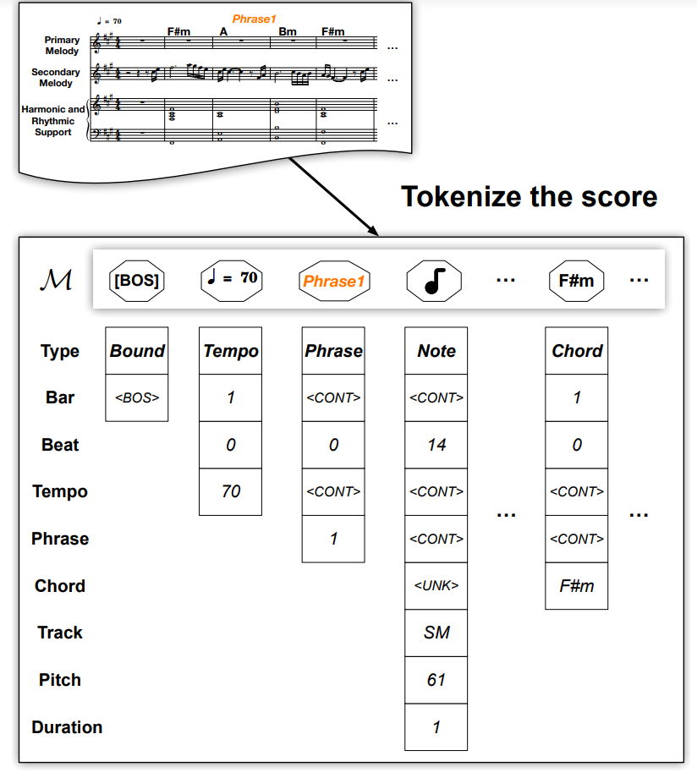
Tokenize

Slide 14
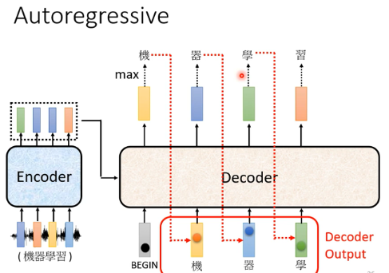
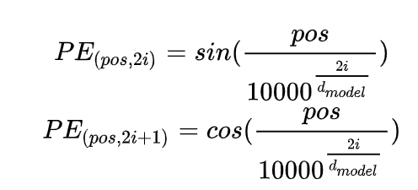
Bottom Song Transformer

Slide 15
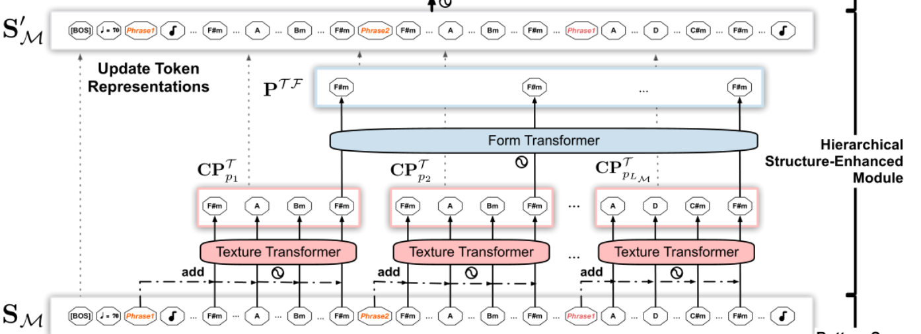
Hierarchical Structure-Enhanced Module

Slide 16
Hierarchical Structure-Enhanced Module- Texture Transformer

Slide 17
Hierarchical Structure-Enhanced Module- Form Transformer

Slide 18
Hierarchical Structure-Enhanced Module- Update Tokens Representations

Slide 19
Training

Slide 20
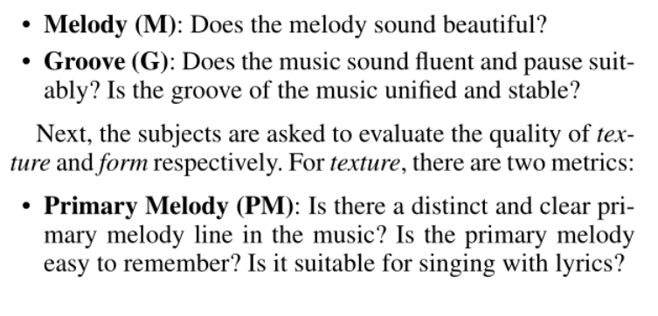
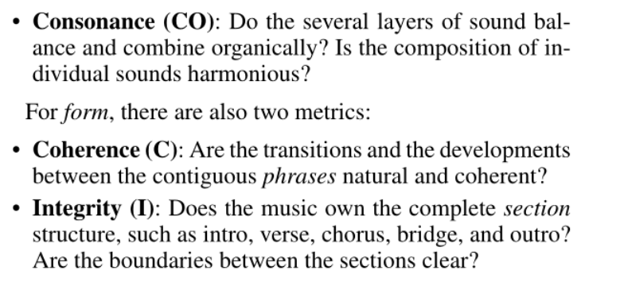
Evaluation
Subjective
Objective
AGS（Accompaniment Groove Stability）
CPR（ Chord Progression Reality）

Slide 21
Thanks for listening!

