Slide 1
Controllable Text Generation (CTG) Warm-up
Stanley Peng
Beihang University
2022.6

Slide 2
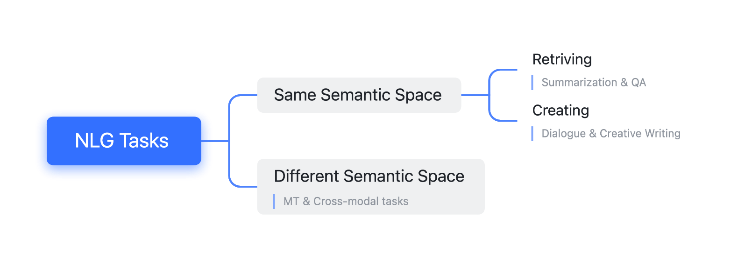
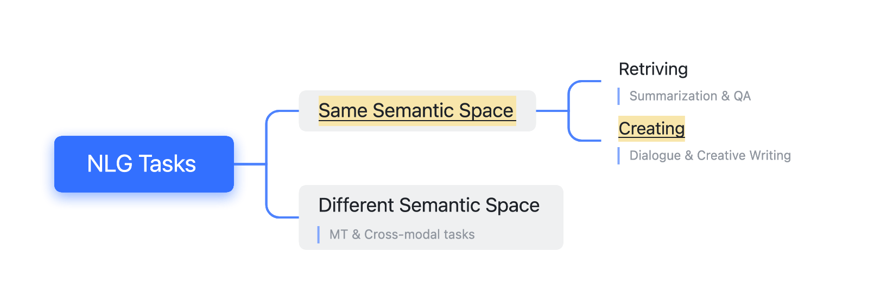
Have a look at NLG Tasks
COCO dataset for image captioning: https://cocodataset.org/#home
Stanford Q&A dataset: https://rajpurkar.github.io/SQuAD-explorer

Slide 3
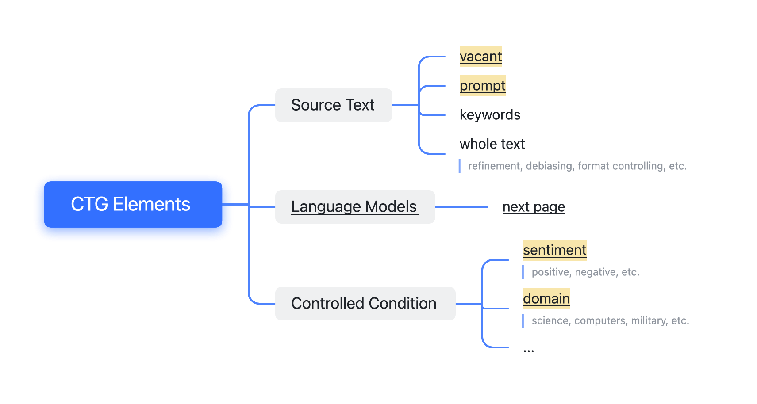
Elements of Controllable Text Generation (CTG)

Slide 4
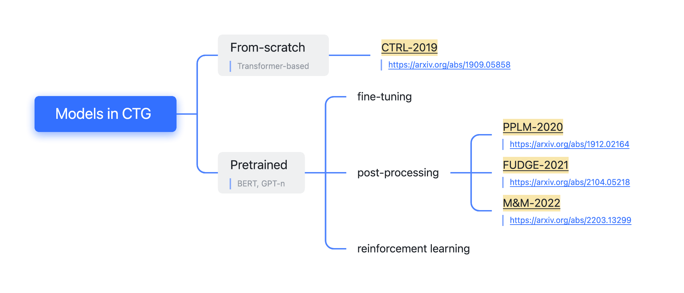
Different Models in CTG

Slide 5
Summarize
 | LM of Model | Pretrained ? | Control Target | Control Conditions

Slide 6
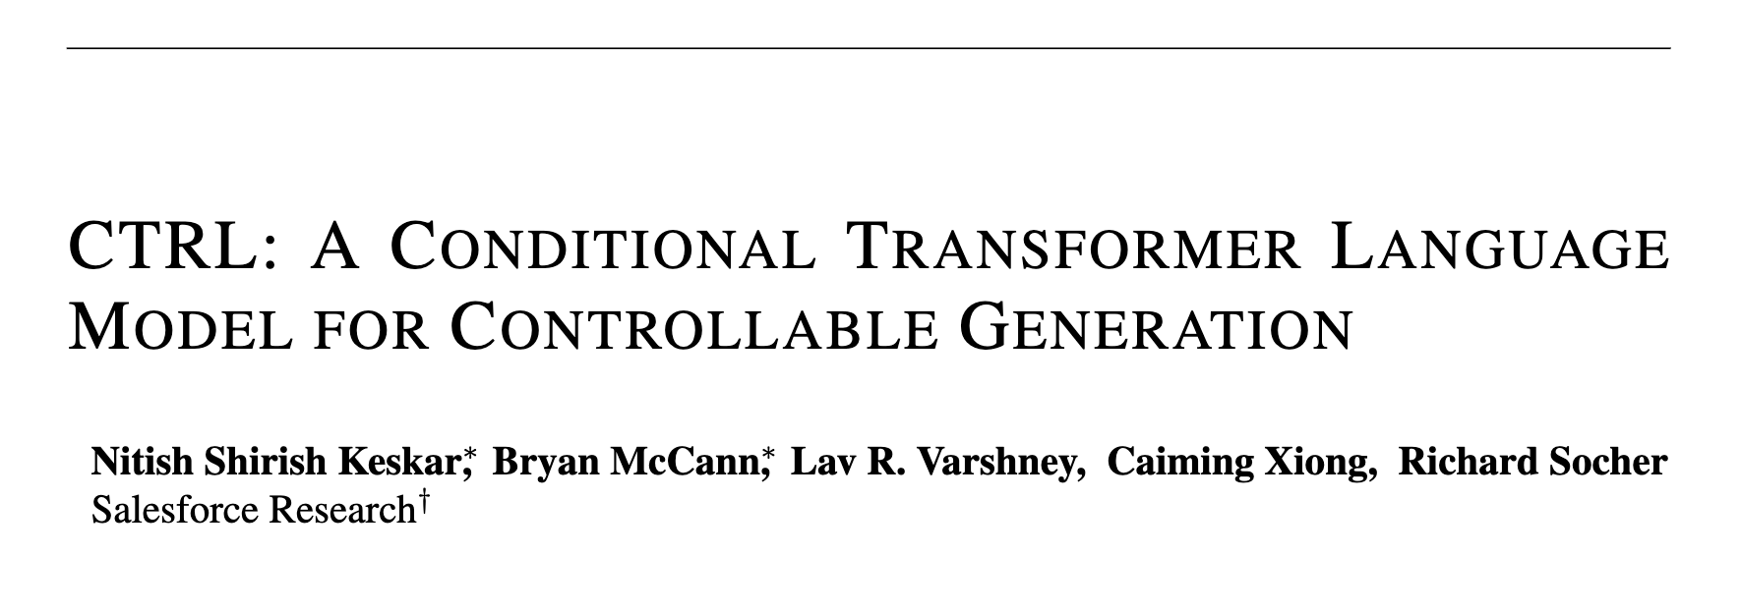
CTRL: A from-scratch controllable model published in ICLR-2019

Slide 7
Method of CTRL
CTRL:

Slide 8
Method of CTRL
CTRL:
Vanilla
Transformer:

Slide 9
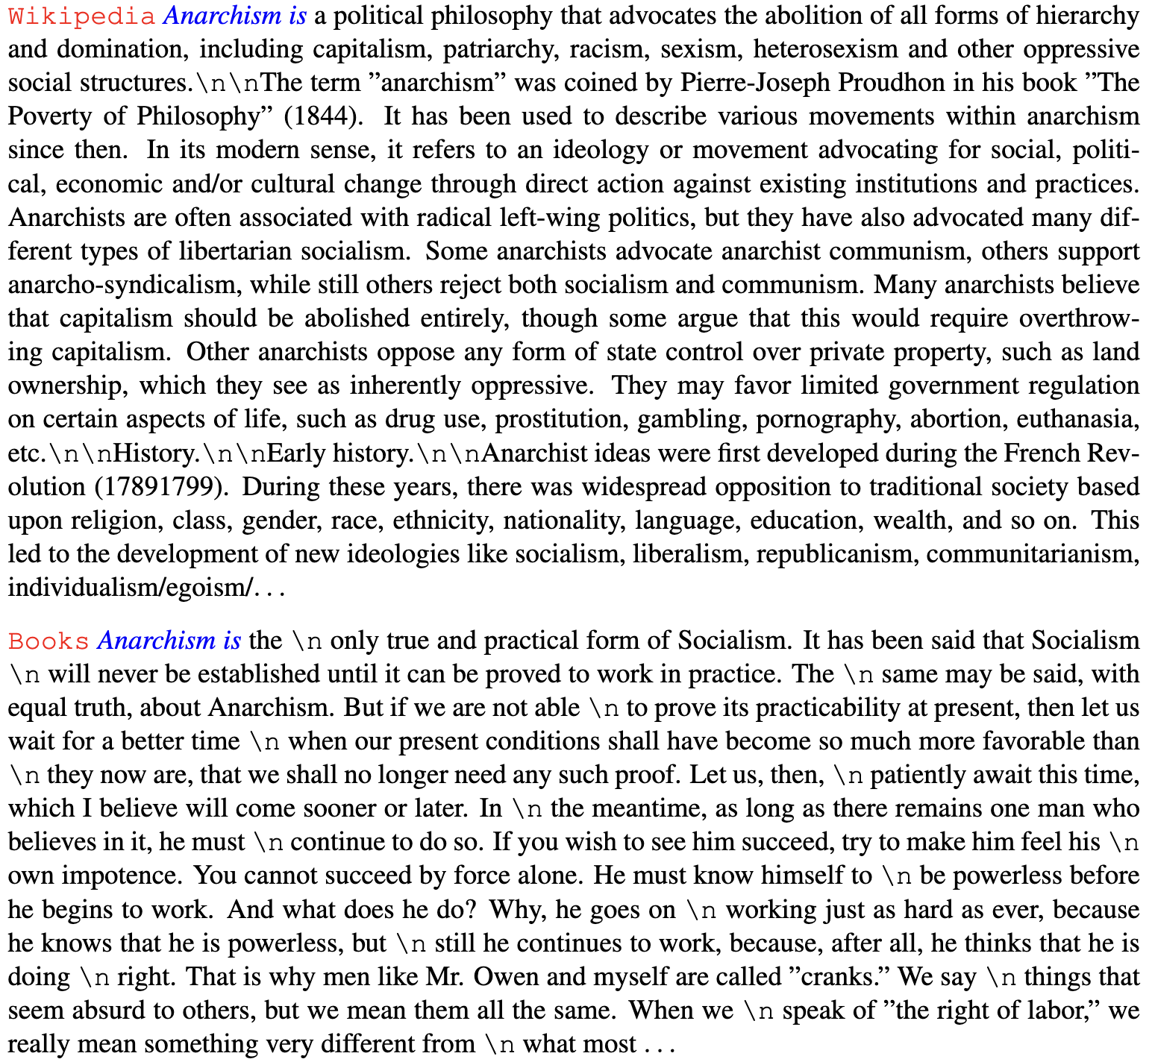
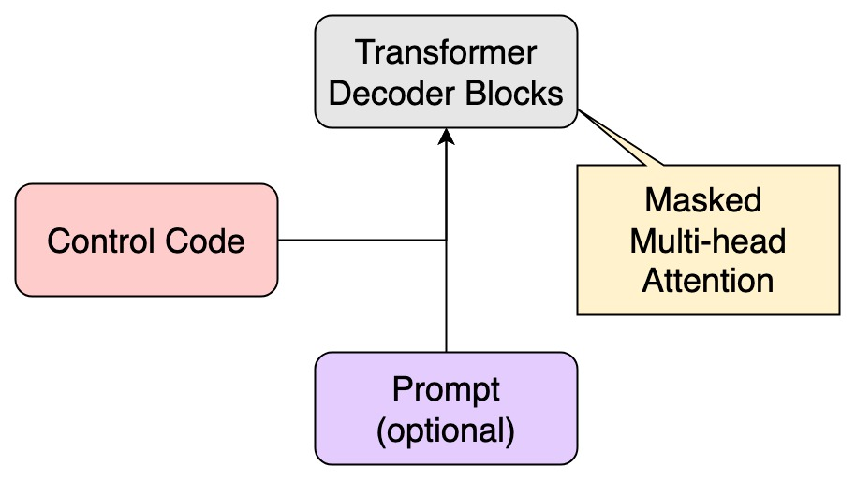
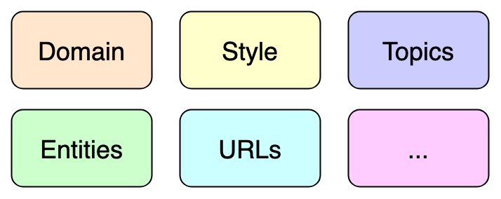
Method of CTRL
Model Architecture
Control Codes

Slide 10
Dataset & Training of CTRL
140GB corpus
250k vocabulary
1.63 billion parameters
Almost no novelty in architecture
Model Architecture
Control Codes

Slide 11
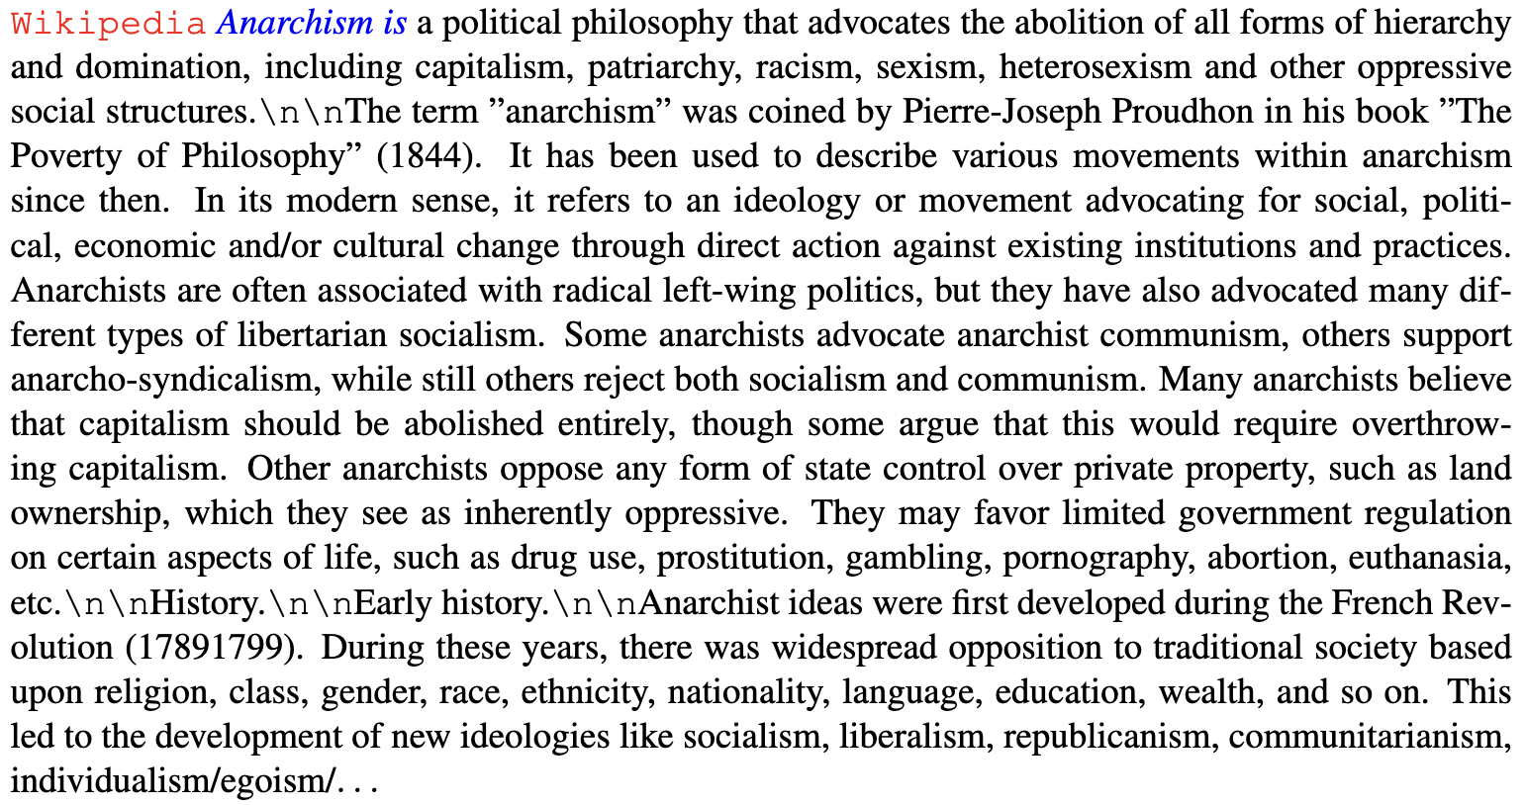
Results of CTRL

Slide 12
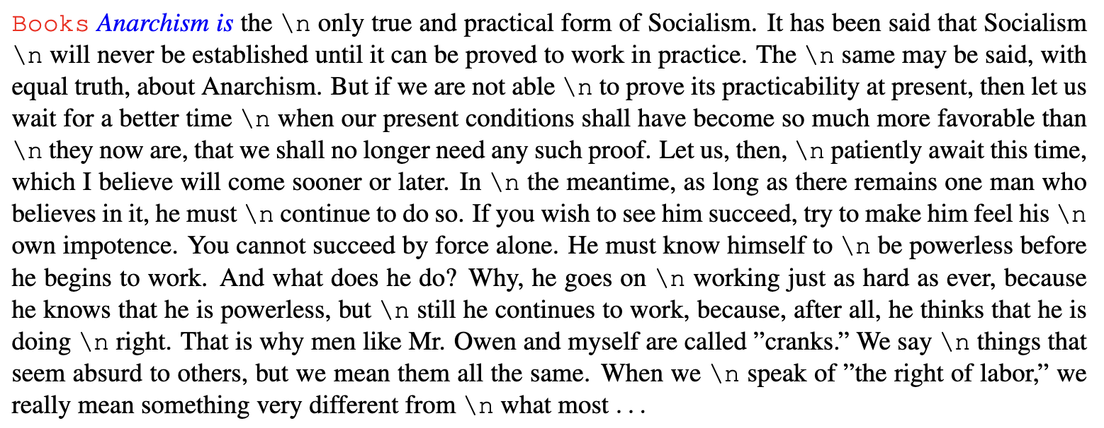
Results of CTRL

Slide 13
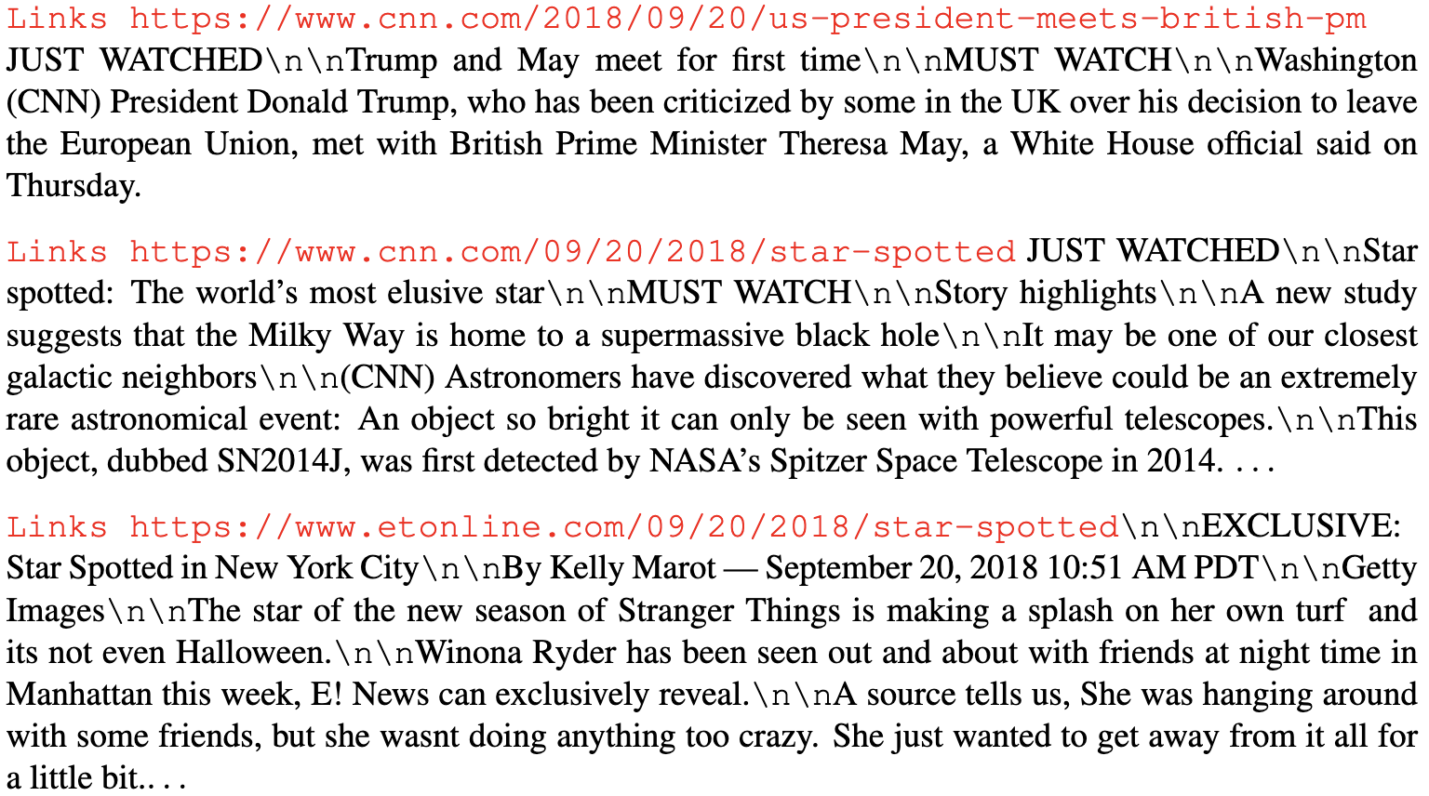
Results of CTRL

Slide 14
Summarize
 | LM of Model | Pretrained ? | Control Target | Control Conditions
CTRL | Transformer Decoder | No | Input | Domain Other Codes

Slide 15
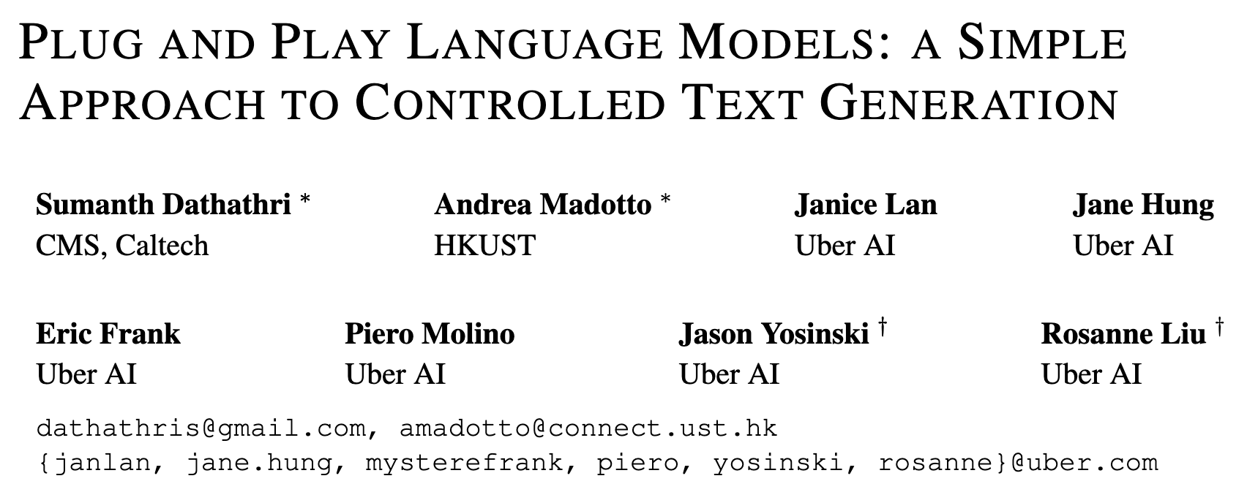
PPLM: A PLM-based controllable model published in ICLR-2020

Slide 16
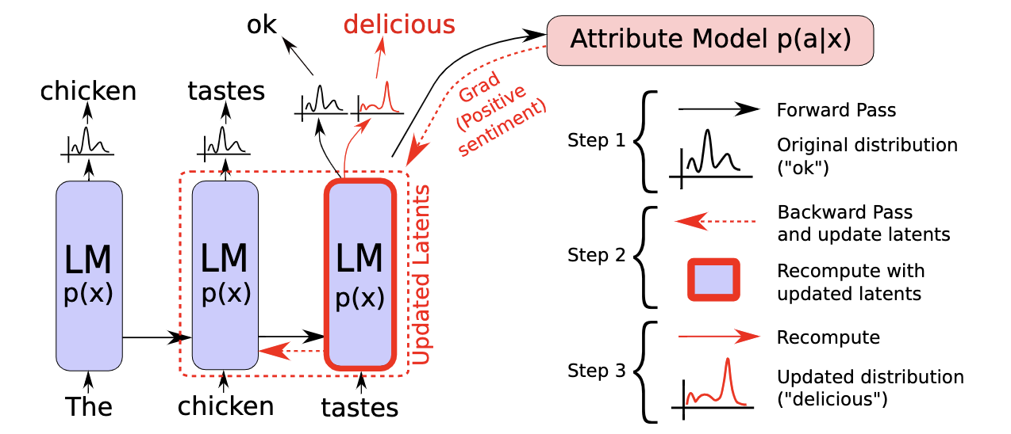
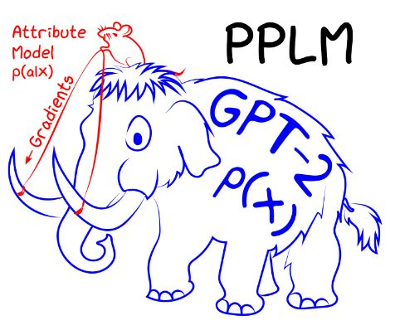
Method of PPLM (Structure)

Slide 17
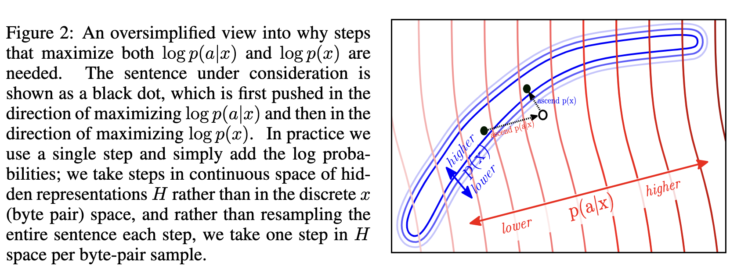
Method of PPLM (Structure)

Slide 18
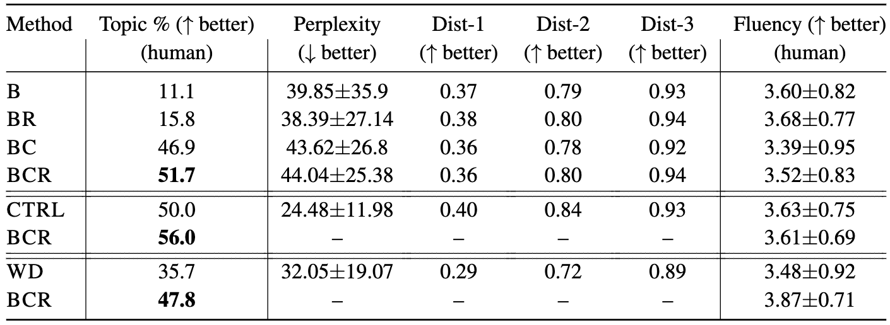
Results of PPLM

Slide 19
Method of PPLM (Discriminator)
Domain types: science, military, legal, computers, space, politics, religion
Each domain has a predefined bag of words (BoW)

Slide 20
Results of PPLM

Slide 21
Summarize
 | LM of Model | Pretrained ? | Control Target | Control Conditions
CTRL | Transformer Decoder | No | Input | Domain Other Codes
PPLM | GPT-2 | Yes | Last Hidden State | Domain Sentiment

Slide 22
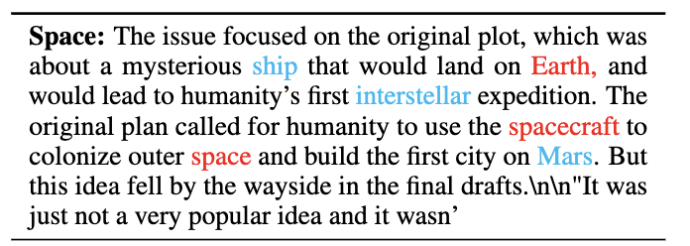
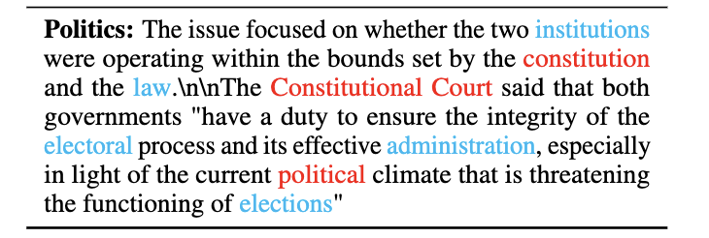
FUDGE: Another discriminator-based controllable model published in NAACL-2021

Slide 23
Method of FUDGE (future discriminator)
FUDGE:
PPLM:

Slide 24
Where does this notion come from?
我跟你说的这个人，他_______________。

Slide 25
Where does this notion come from?
我跟你说的这个人，他_______________。
我真的不喜欢在背后说别人坏话，但是 我跟你说的这个人，他_______________。

Slide 26
Where does this notion come from?
I regret not getting to know him sooner because he is so kind -- Positive
我后悔没能早点认识他，因为他太善良了
I regret not lending him a helping hand -- Neutral
我后悔没有向他伸出援助之手
I regret knowing him because he‘s a complete idiot -- Negative
我后悔认识他，因为他是个十足的笨蛋
PPLM: Each domain has a predefined bag of words (BoW)

Slide 27
Summarize
 | LM of Model | Pretrained ? | Control Target | Control Conditions
CTRL | Transformer Decoder | No | Input | Domain Other Codes
PPLM | GPT-2 | Yes | Last Hidden State | Domain Sentiment
FUDGE | GPT-2 | Yes | Next Word Distribution | Domain / Format Sentiment
5种抑扬格，头尾韵的押韵方式（联韵、交叉韵、同韵）

Slide 28
M&M: A BERT-based controllable model published in ACL-2022

Slide 29
M&M: A BERT-based controllable model published in ACL-2022
The movie [MASK] [MASK] [MASK] [MASK] [MASK] [MASK] [MASK] [MASK] [MASK].

Slide 30
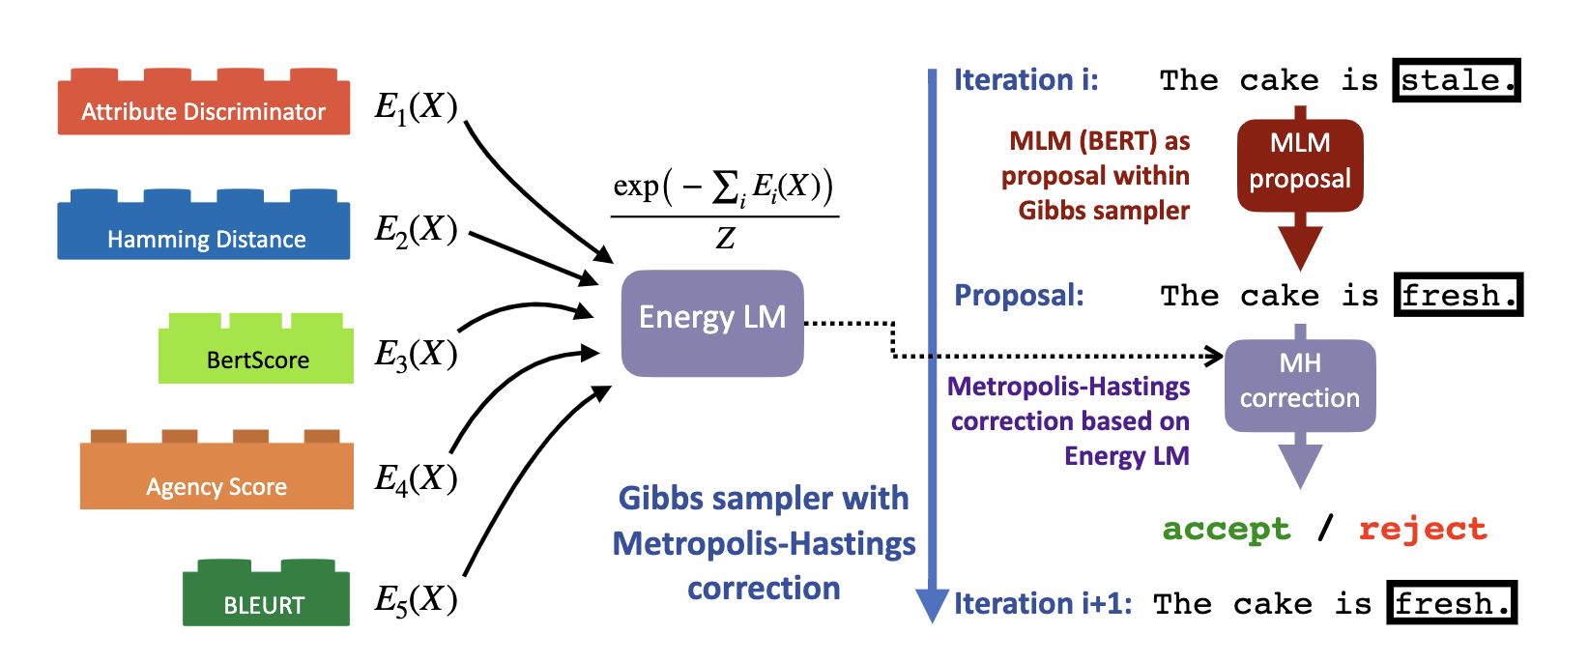
Method of M&M

Slide 31
Method of M&M
Use BERT to determine whether the sentence is well-formed
Use attribute-discriminator to determine whether the sentence satisfies the given control condition
Use Hamming-distance to minimize the count of edits
Almost the same as Hamming-distance, but take sentiment into account

Slide 32
Summarize
 | LM of Model | Pretrained ? | Control Target | Control Conditions
CTRL | Transformer Decoder | No | Input | Domain Other Codes
PPLM | GPT-2 | Yes | Last Hidden State | Domain Sentiment
FUDGE | GPT-2 | Yes | Next Word Distribution | Domain / Format Sentiment
M&M | BERT | Yes | Next Word Distribution | Domain / Format Sentiment

Slide 33
Have a look at loss functions

Slide 34
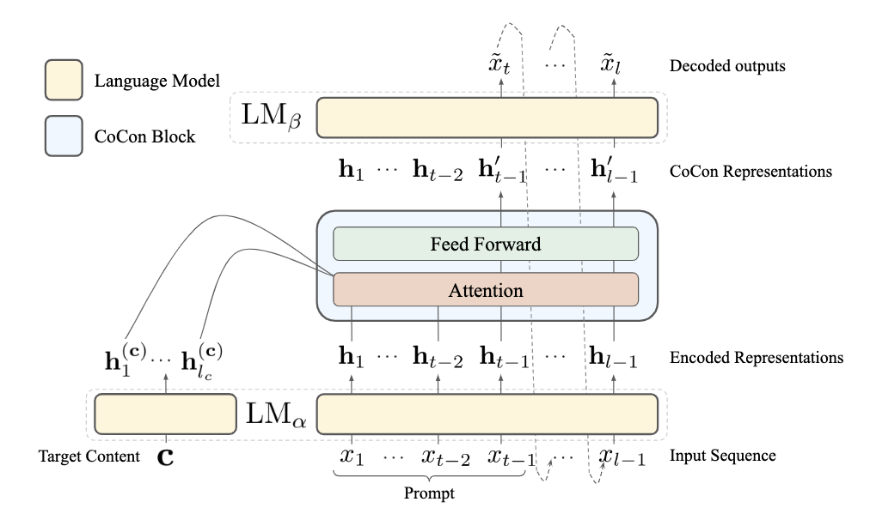
Method of CoCon

Slide 35
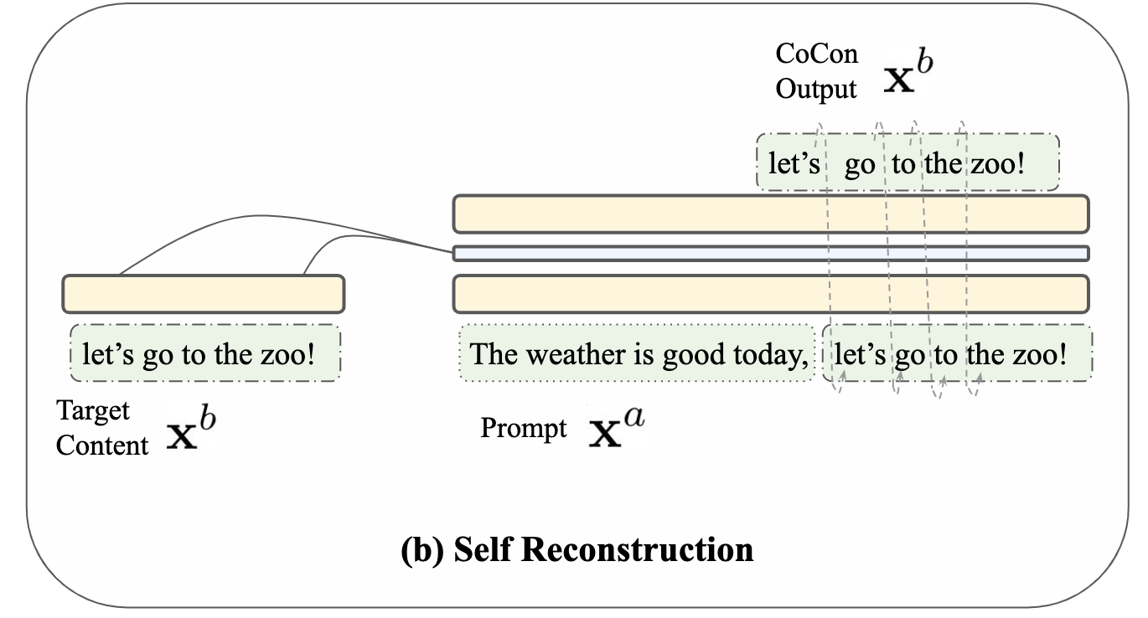
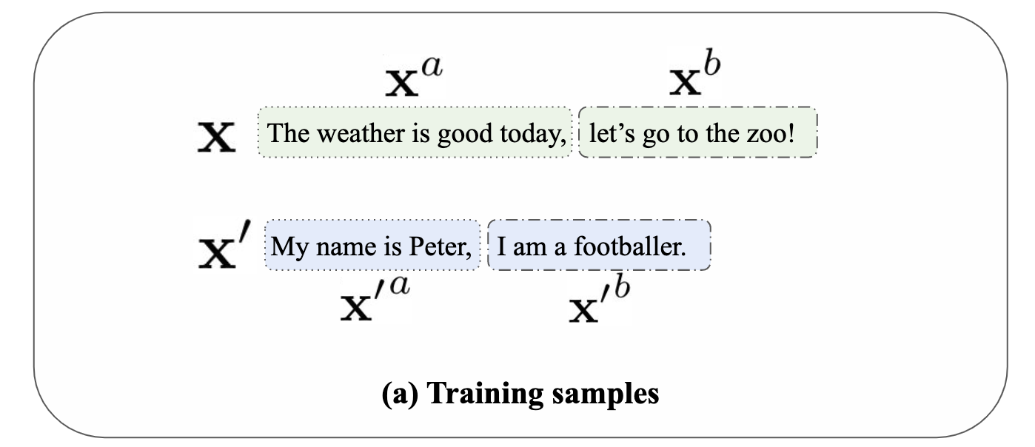
Have a look at loss functions of CoCon
Self Reconstruction Loss
Null Content Loss

Slide 36
Have a look at 4 loss functions of CoCon
Self Reconstruction Loss
Null Content Loss

Slide 37
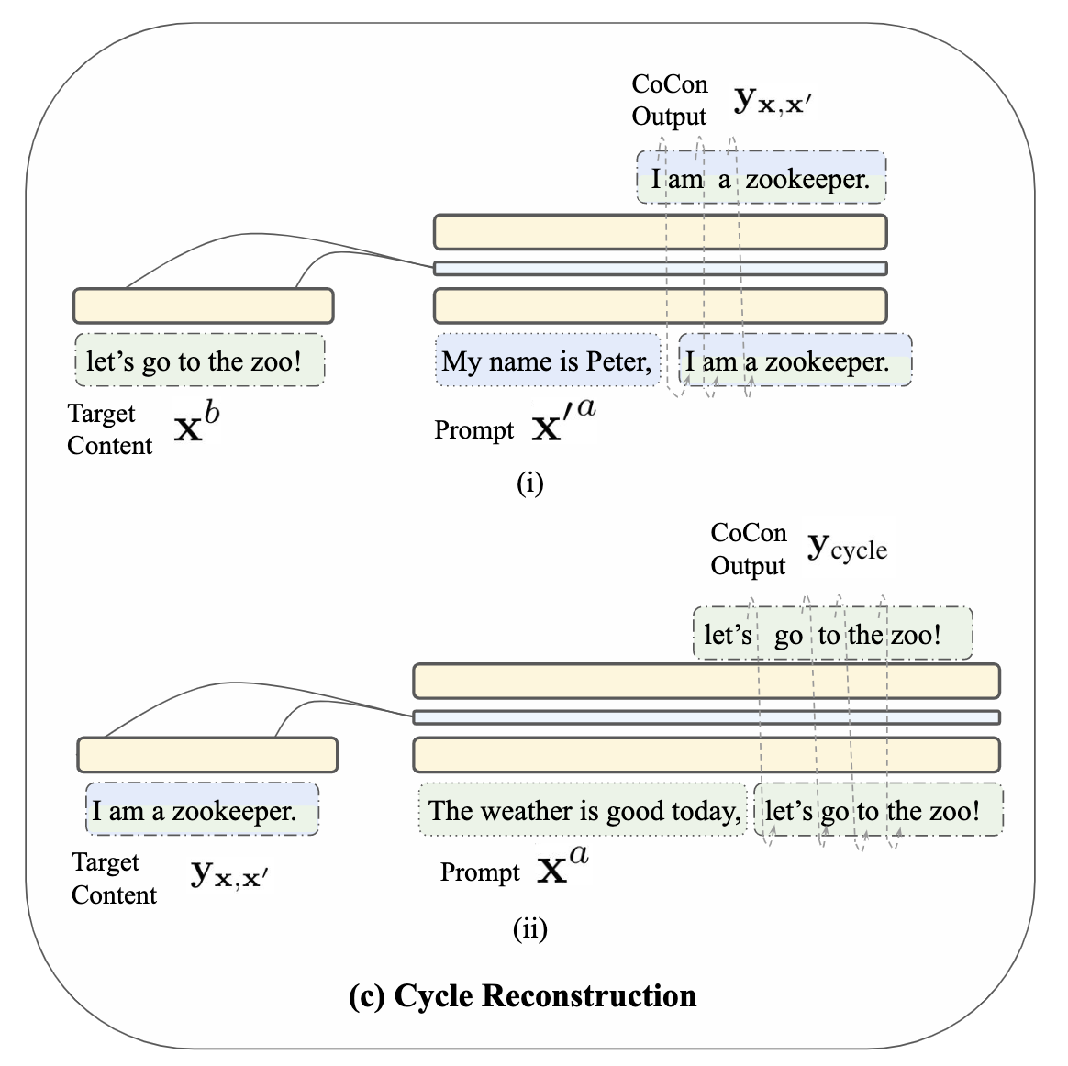
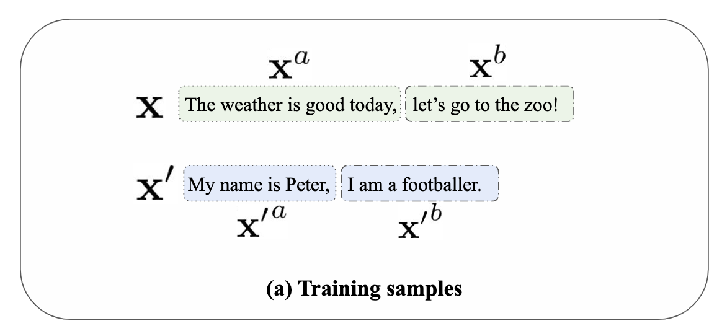
Have a look at 4 loss functions of CoCon
Cycle Reconstruction Loss
Adversarial Loss
Full Training Loss

Slide 38
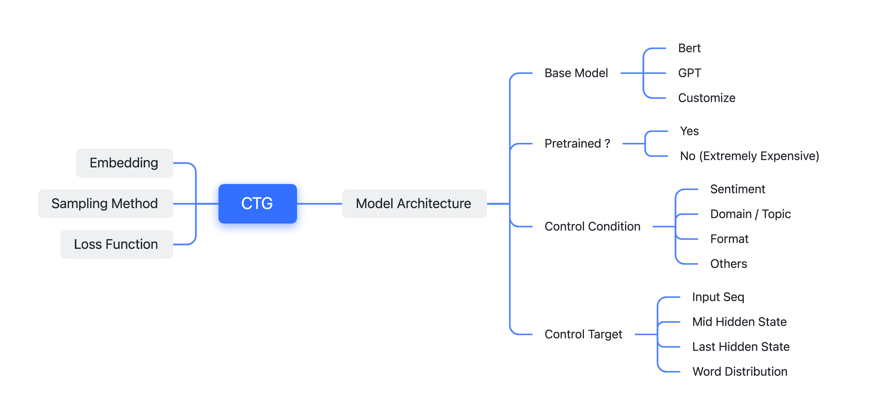
What Can We Do?

Slide 39
Summarize
 | LM of Model | Pretrained ? | Control Target | Control Conditions
CTRL | Transformer Decoder | No | Input | Domain Other Codes
PPLM | GPT-2 | Yes | Last Hidden State | Domain Sentiment
FUDGE | GPT-2 | Yes | Next Word Distribution | Domain / Format Sentiment
M&M | BERT | Yes | Next Word Distribution | Domain / Format Sentiment

