Slide 1
2022 CVPR

Slide 2
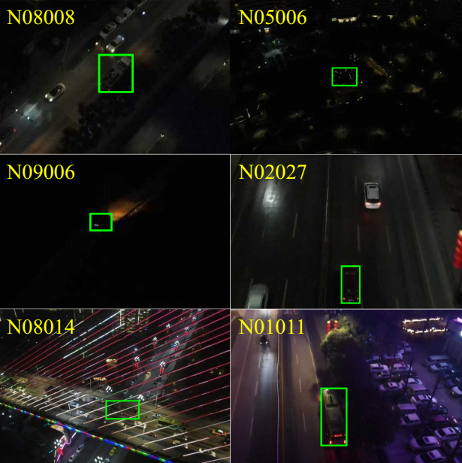
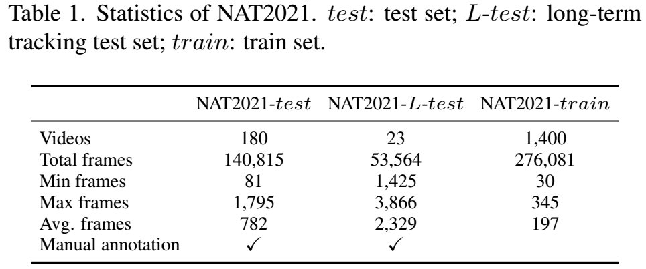
Nighttime Aerial Tracking benchmark，NAT2021
---Captured in nighttime (low constrast, low brightness,
low signal-to-noise ratio) by UAV
---12 attributes

Slide 3
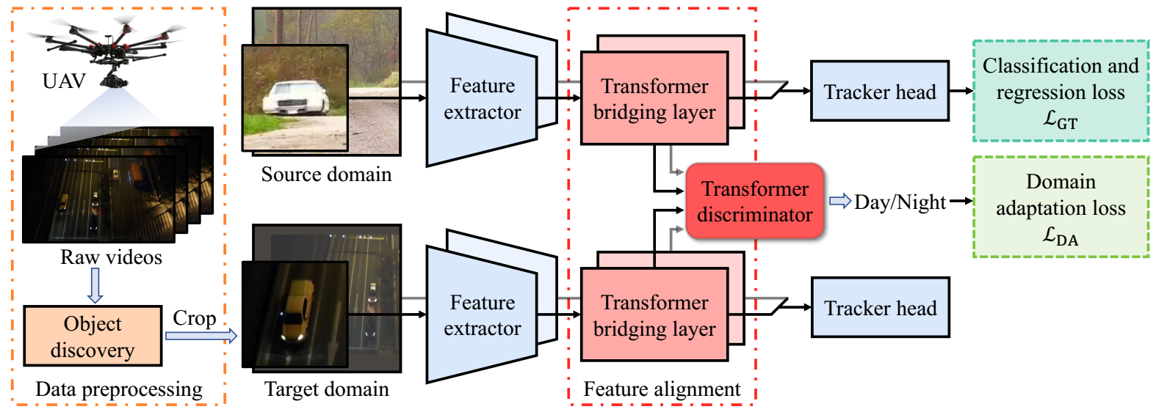
Unsupervised Domain Adaptive Tracking, UDAT

Slide 4
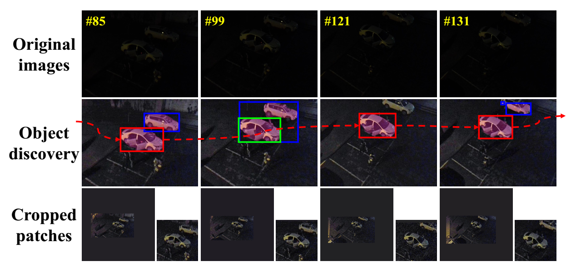
Data preprocessing: low-light enhancement, salient object detection, and dynamic programming.

Slide 5
Unsupervised Domain Adaptive Tracking, UDAT

Slide 6
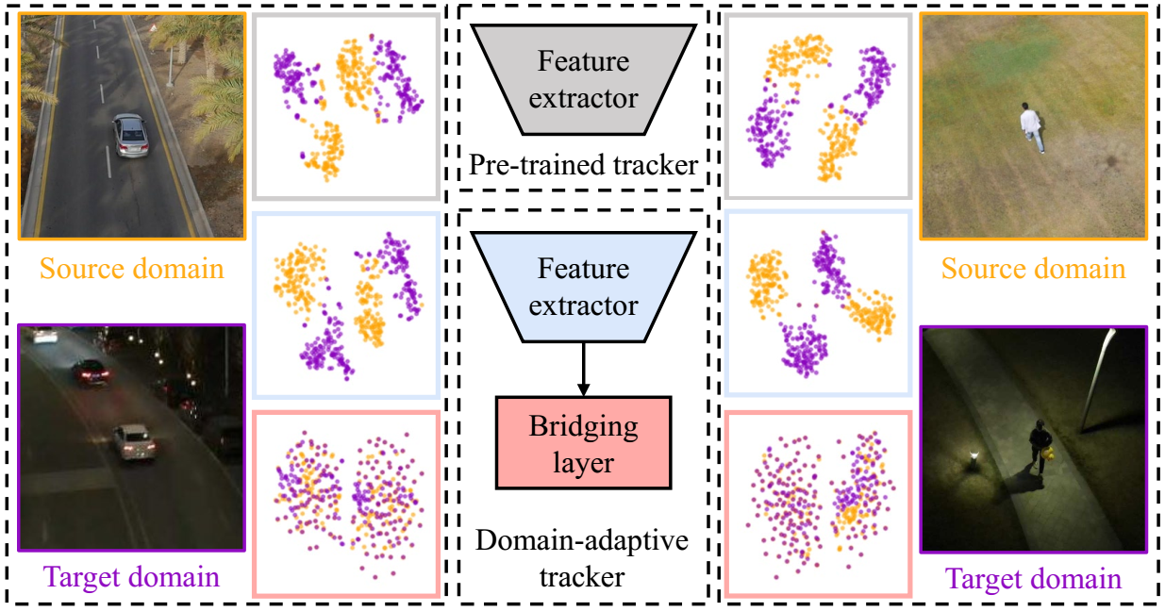

Slide 7
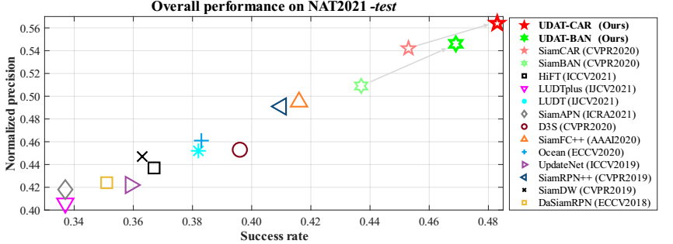
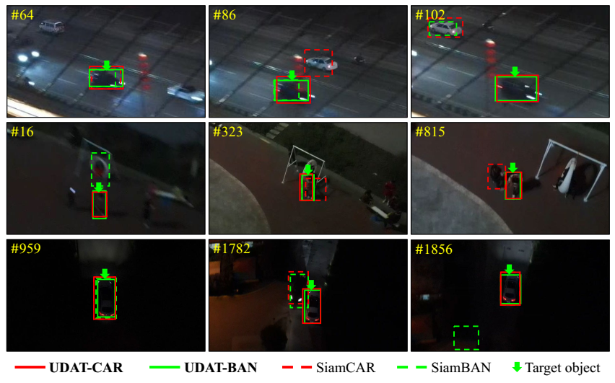
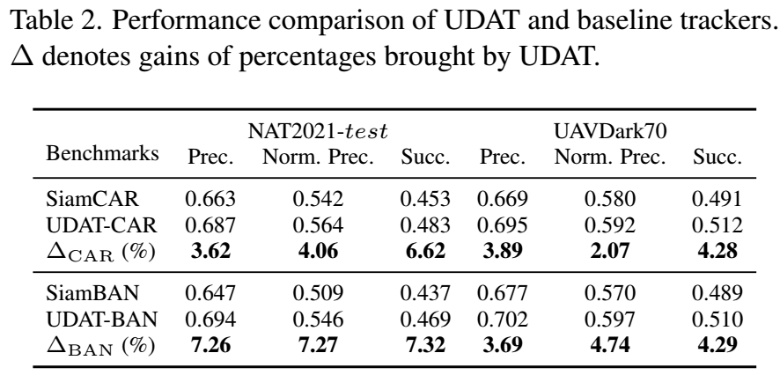

Slide 8
