Slide 1
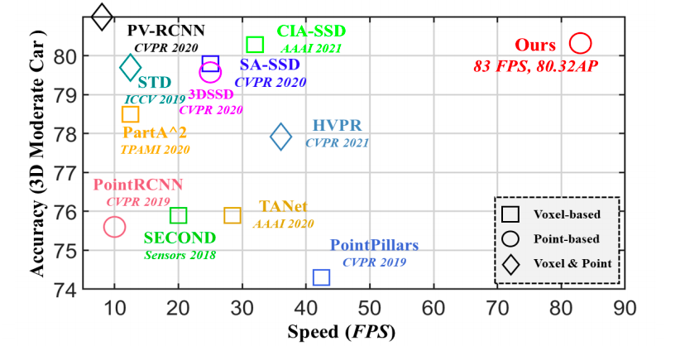
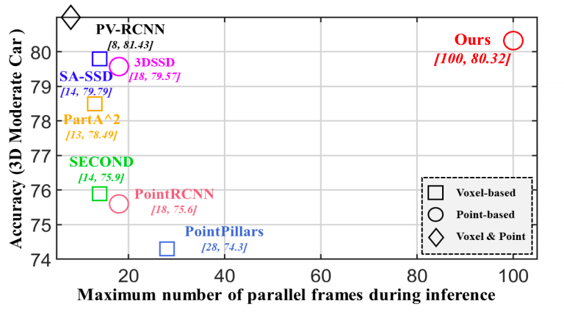
2022 cvpr oral
Notes:
All experiments are conducted on a single RTX2080Ti GPU.
The FPS is calculated with the full utilization of GPU memory

Slide 2
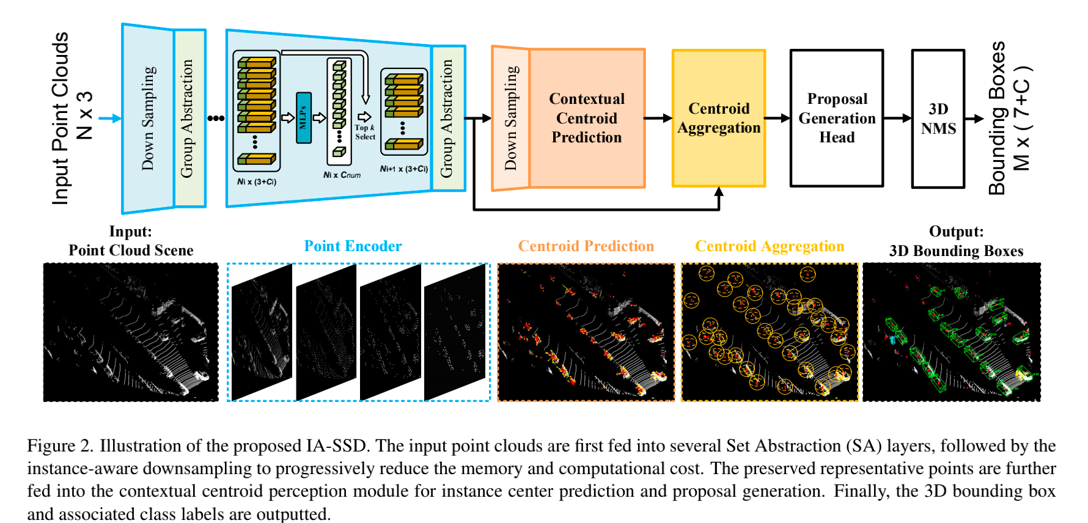
Instance-aware downsampling
Contextual Instance Centroid Perception
· Sample layer：主要是对输入点进行采样，在这些点中选出若干个中心点
· Grouping layer：是利用上一步得到的中心点将点集划分成若干个区域； · PointNet layer：是对上述得到的每个区域进行编码，变成特征向量。

Slide 3
Instance-aware downsampling
Class-aware Sampling.
Inference的时候取分数topk的作为代表性的点进入下一encode layer
Centroid-aware Sampling

Slide 4
Contextual Instance Centroid Perception
Contextual Centroid Prediction
∆cij denotes the ground-truth offset from point pij to the center point.
a regularization term is added to minimize the uncertainty of the centroid prediction. all votes per instance are aggregated
in light of the surrounding interference, where the ci is the mean destination of i-th instance
IS is an indicator function to determine whether this point is used to estimate the instance center or not. Expand the
ground-truth bounding boxes or proportional enlarge the box to cover more related context near the objects

Slide 5
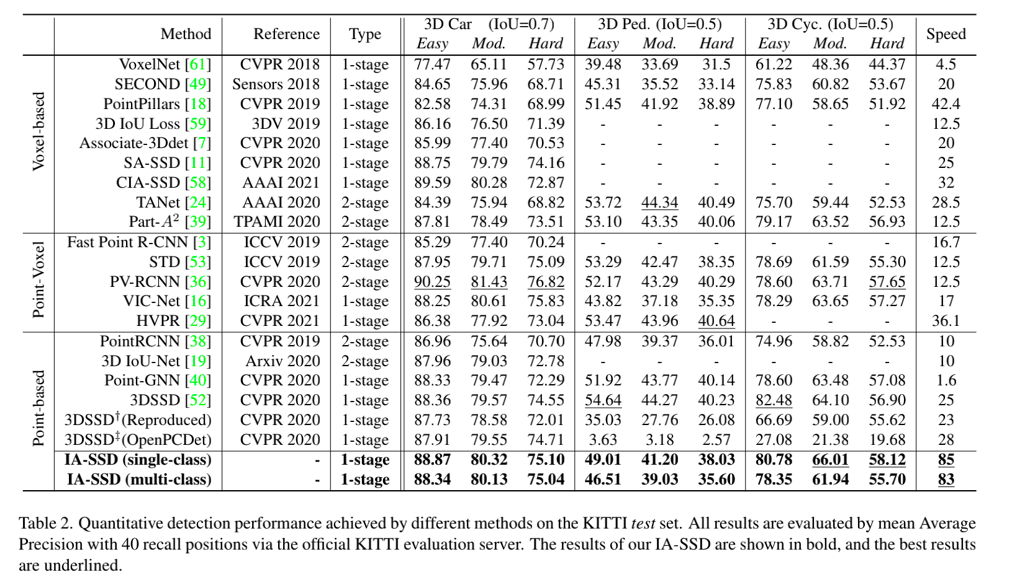
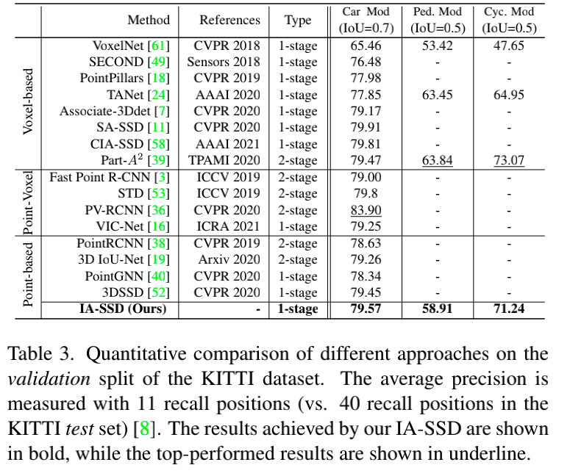
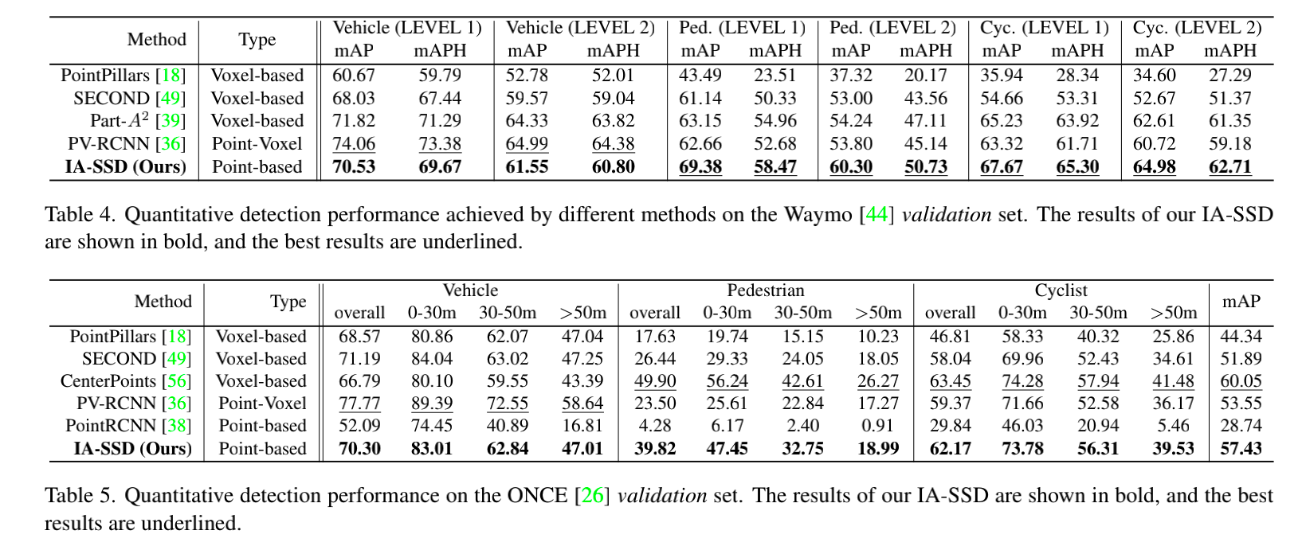

Slide 6
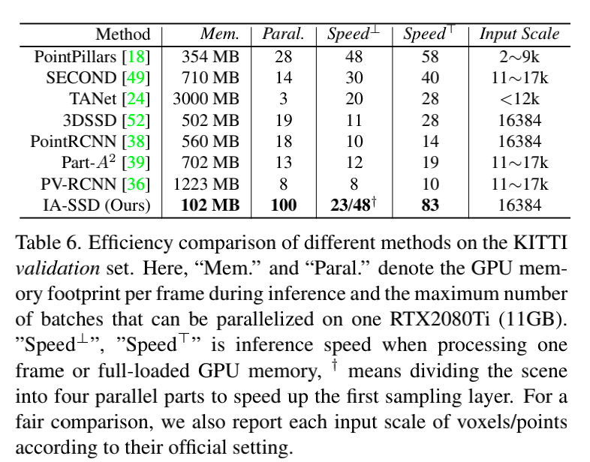
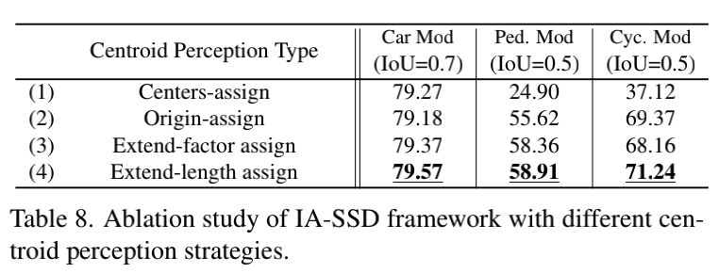
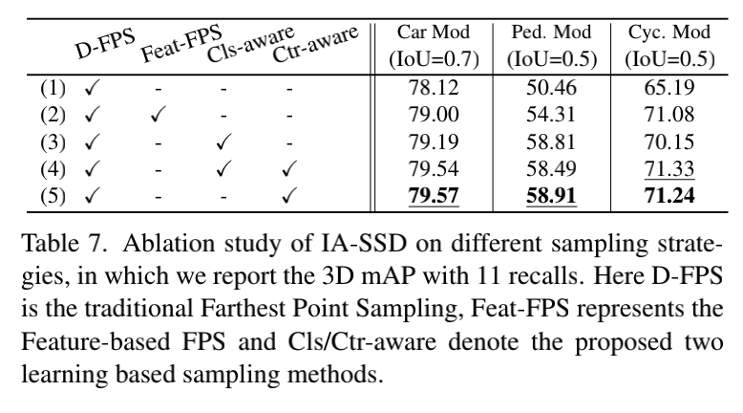
sampling strategy focus on the instance center,
hence tends to ignore the distal geometric details of objects
such as cyclist with large aspect ratios.

